Slide 1

Office of environmental health & safety (OEHS)
Time-sensitive chemicals management
Presenters:
Marcel Charbonnet
Haylie Tucker

Slide 2
What are time Sensitive chemicals?
Chemicals with the potential to develop additional hazards over time which are different from their hazards in the original formulation.
Additional Hazards
Become explosive
Form more toxic products
Damaged containers break or rupture, releasing toxic or corrosive contents

Slide 3
time-sensitive chemical concerns
Serious Injuries
Property Damage
Disruption of Campuses
High Costs of Disposal
Reputational Damage to Universities

Slide 4
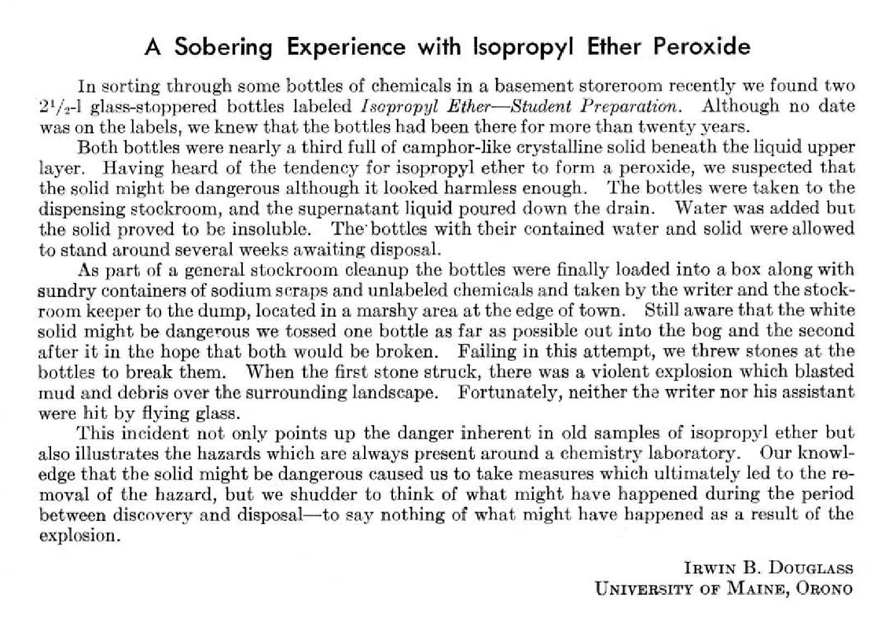
See Handout. J of Chemical Education, 1963
Notes:
1963 Published description of mismanaged chemicals
Journal of Chemical Education
J. Chem. Educ. 1963, 40, 9, 469
https://pubs.acs.org/doi/10.1021/ed040p469
Serious safety issues in the era prior to regulators such as EPA and DOT. Even with modern rules and regulations, these chemicals are still causing chemical safety incidents at institutions today.

Slide 5
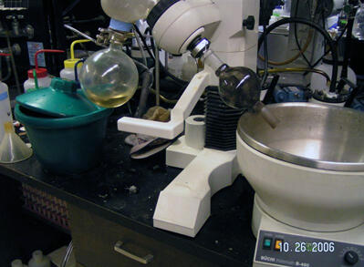
Time-sensitive chemical incidents
2006 Lab Rotovap Explosion
UC Berkely
Undergraduate evaporating solvents (Tetrahydrofuran (THF) and Diethyl Ether) from precipitate
Source bottles were aged and had accumulated peroxides
Solvent exploded, causing lacerations to the student’s face and chest

Slide 6
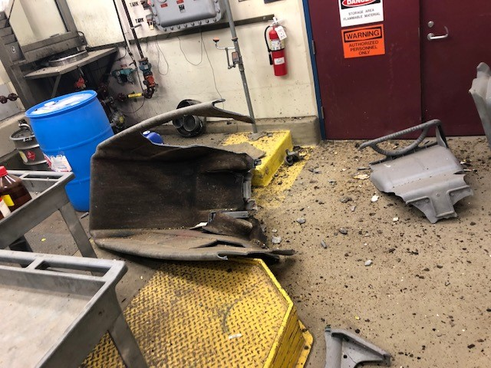
Time-sensitive chemical incidents
2017 Waste Room Explosion
U of Minnesota
Waste tech deposited an emptied solvent bottle in a waste cart when it exploded, blasting the cart in half and damaging the room
Caused by Peroxide residues in an old solvent bottle (unidentified)
Notes:
University of Minnesota webpage about the incident:
https://hsrm.umn.edu/sites/hsrm.umn.edu/files/2021-10/safety_alert_-_thompson_explosion_aug19.pdf

Slide 7
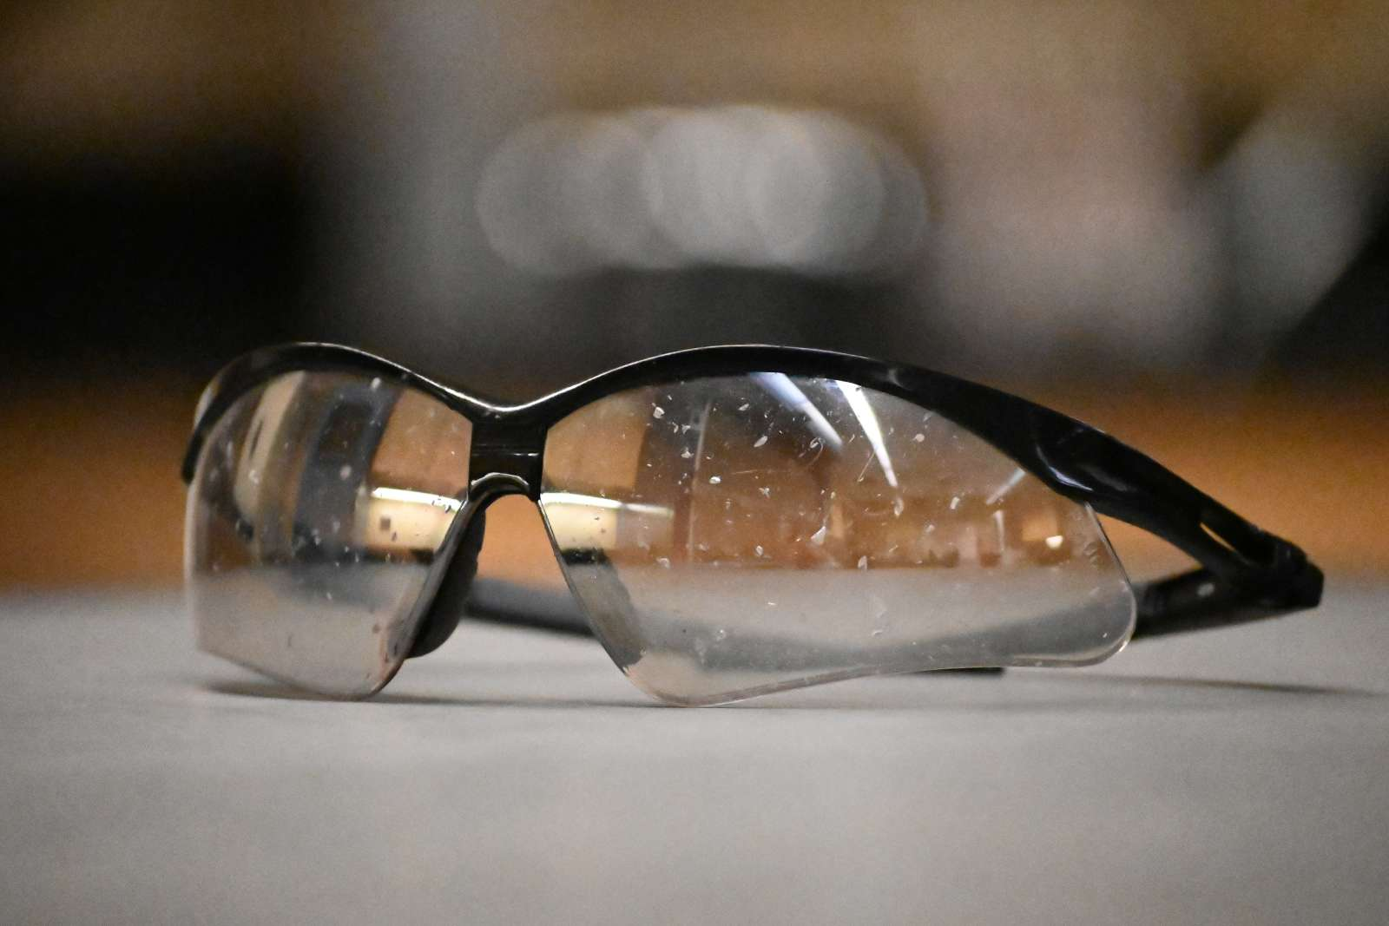
Time-sensitive chemical incidents
2023 Waste Room Explosion
Iowa State University
Lab Cleanout from an inactive researcher
Bottles of isopropanol stored in direct sunlight on an inactive HPLC for approx. 12-15 years.
Detonated in the hands of the waste tech, causing severe injury to hands, face, and neck requiring hospitalization.

Slide 8
Time-sensitive chemical incidents
2019 Dry Picric Acid Discovery
U Texas -Austin
While taking a lab inventory, researcher discovered abandoned container
Approx. 50g of completely dry Picric Acid. Unknown age/origin.
Lab shut down for 2.5 days
$6,000 disposal cost

Slide 9
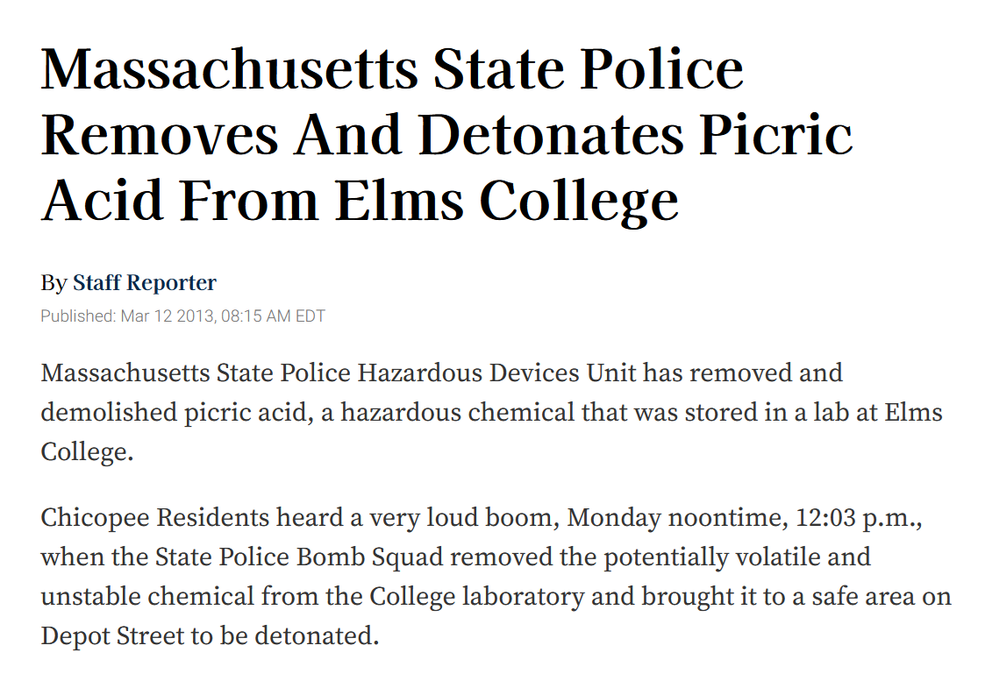
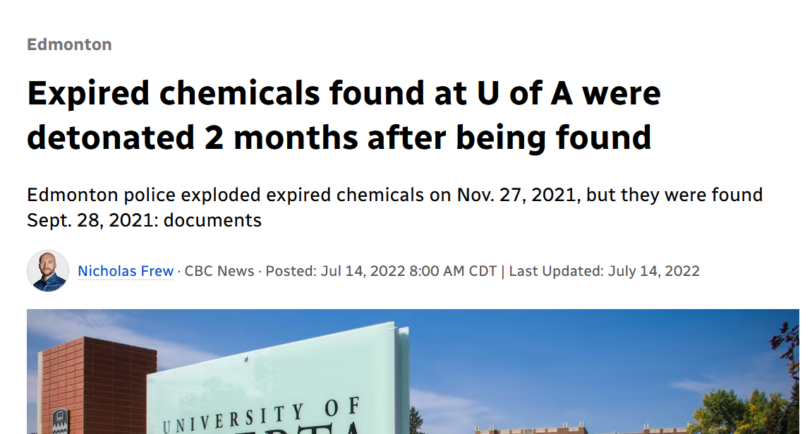
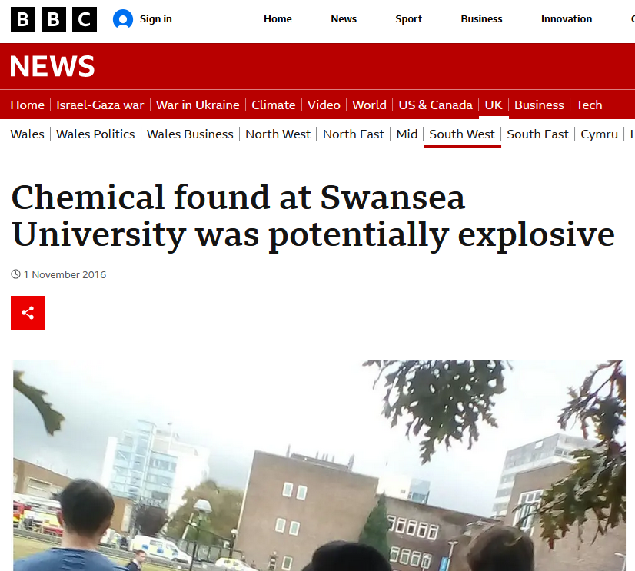
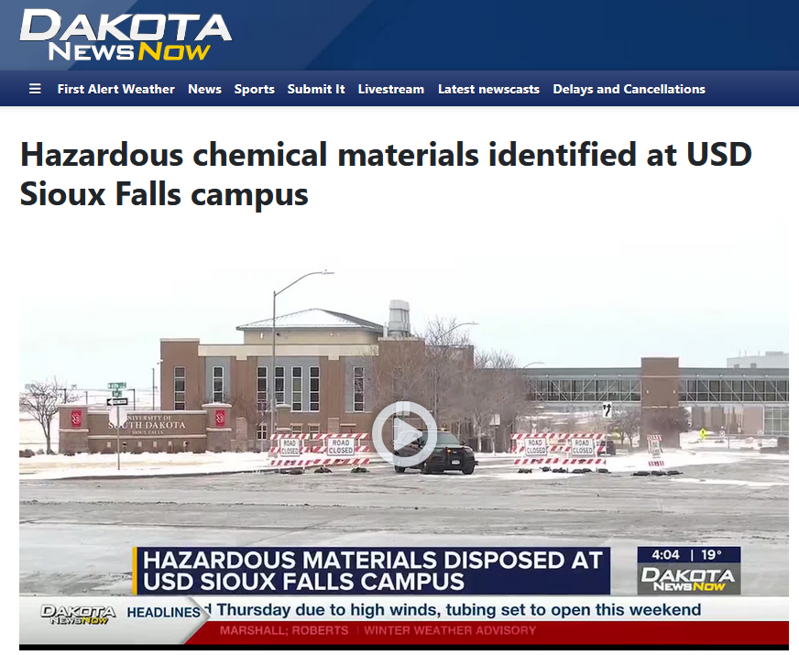
Time-sensitive chemicals – potential Reputational damage
News outlets exaggerate or misrepresent level of hazard
Public may believe institution is unsafe
Even for planned destruction/detonation of chemicals by local authorities
Notes:
Picric Acid detonation:
https://www.universityherald.com/articles/2955/20130312/massachusetts-state-police-removes-detonates-picric-acid.htm
Peroxide Former detonated by bomb squad:
https://www.cbc.ca/news/canada/edmonton/university-alberta-chemical-detonation-1.6519999
Campus closed for pickup of expired peroxide formers:
https://www.dakotanewsnow.com/2024/12/19/hazardous-chemical-materials-identified-usd-sioux-falls-campus/
Picric acid discovery:
https://www.bbc.com/news/uk-wales-south-west-wales-37839779

Slide 10
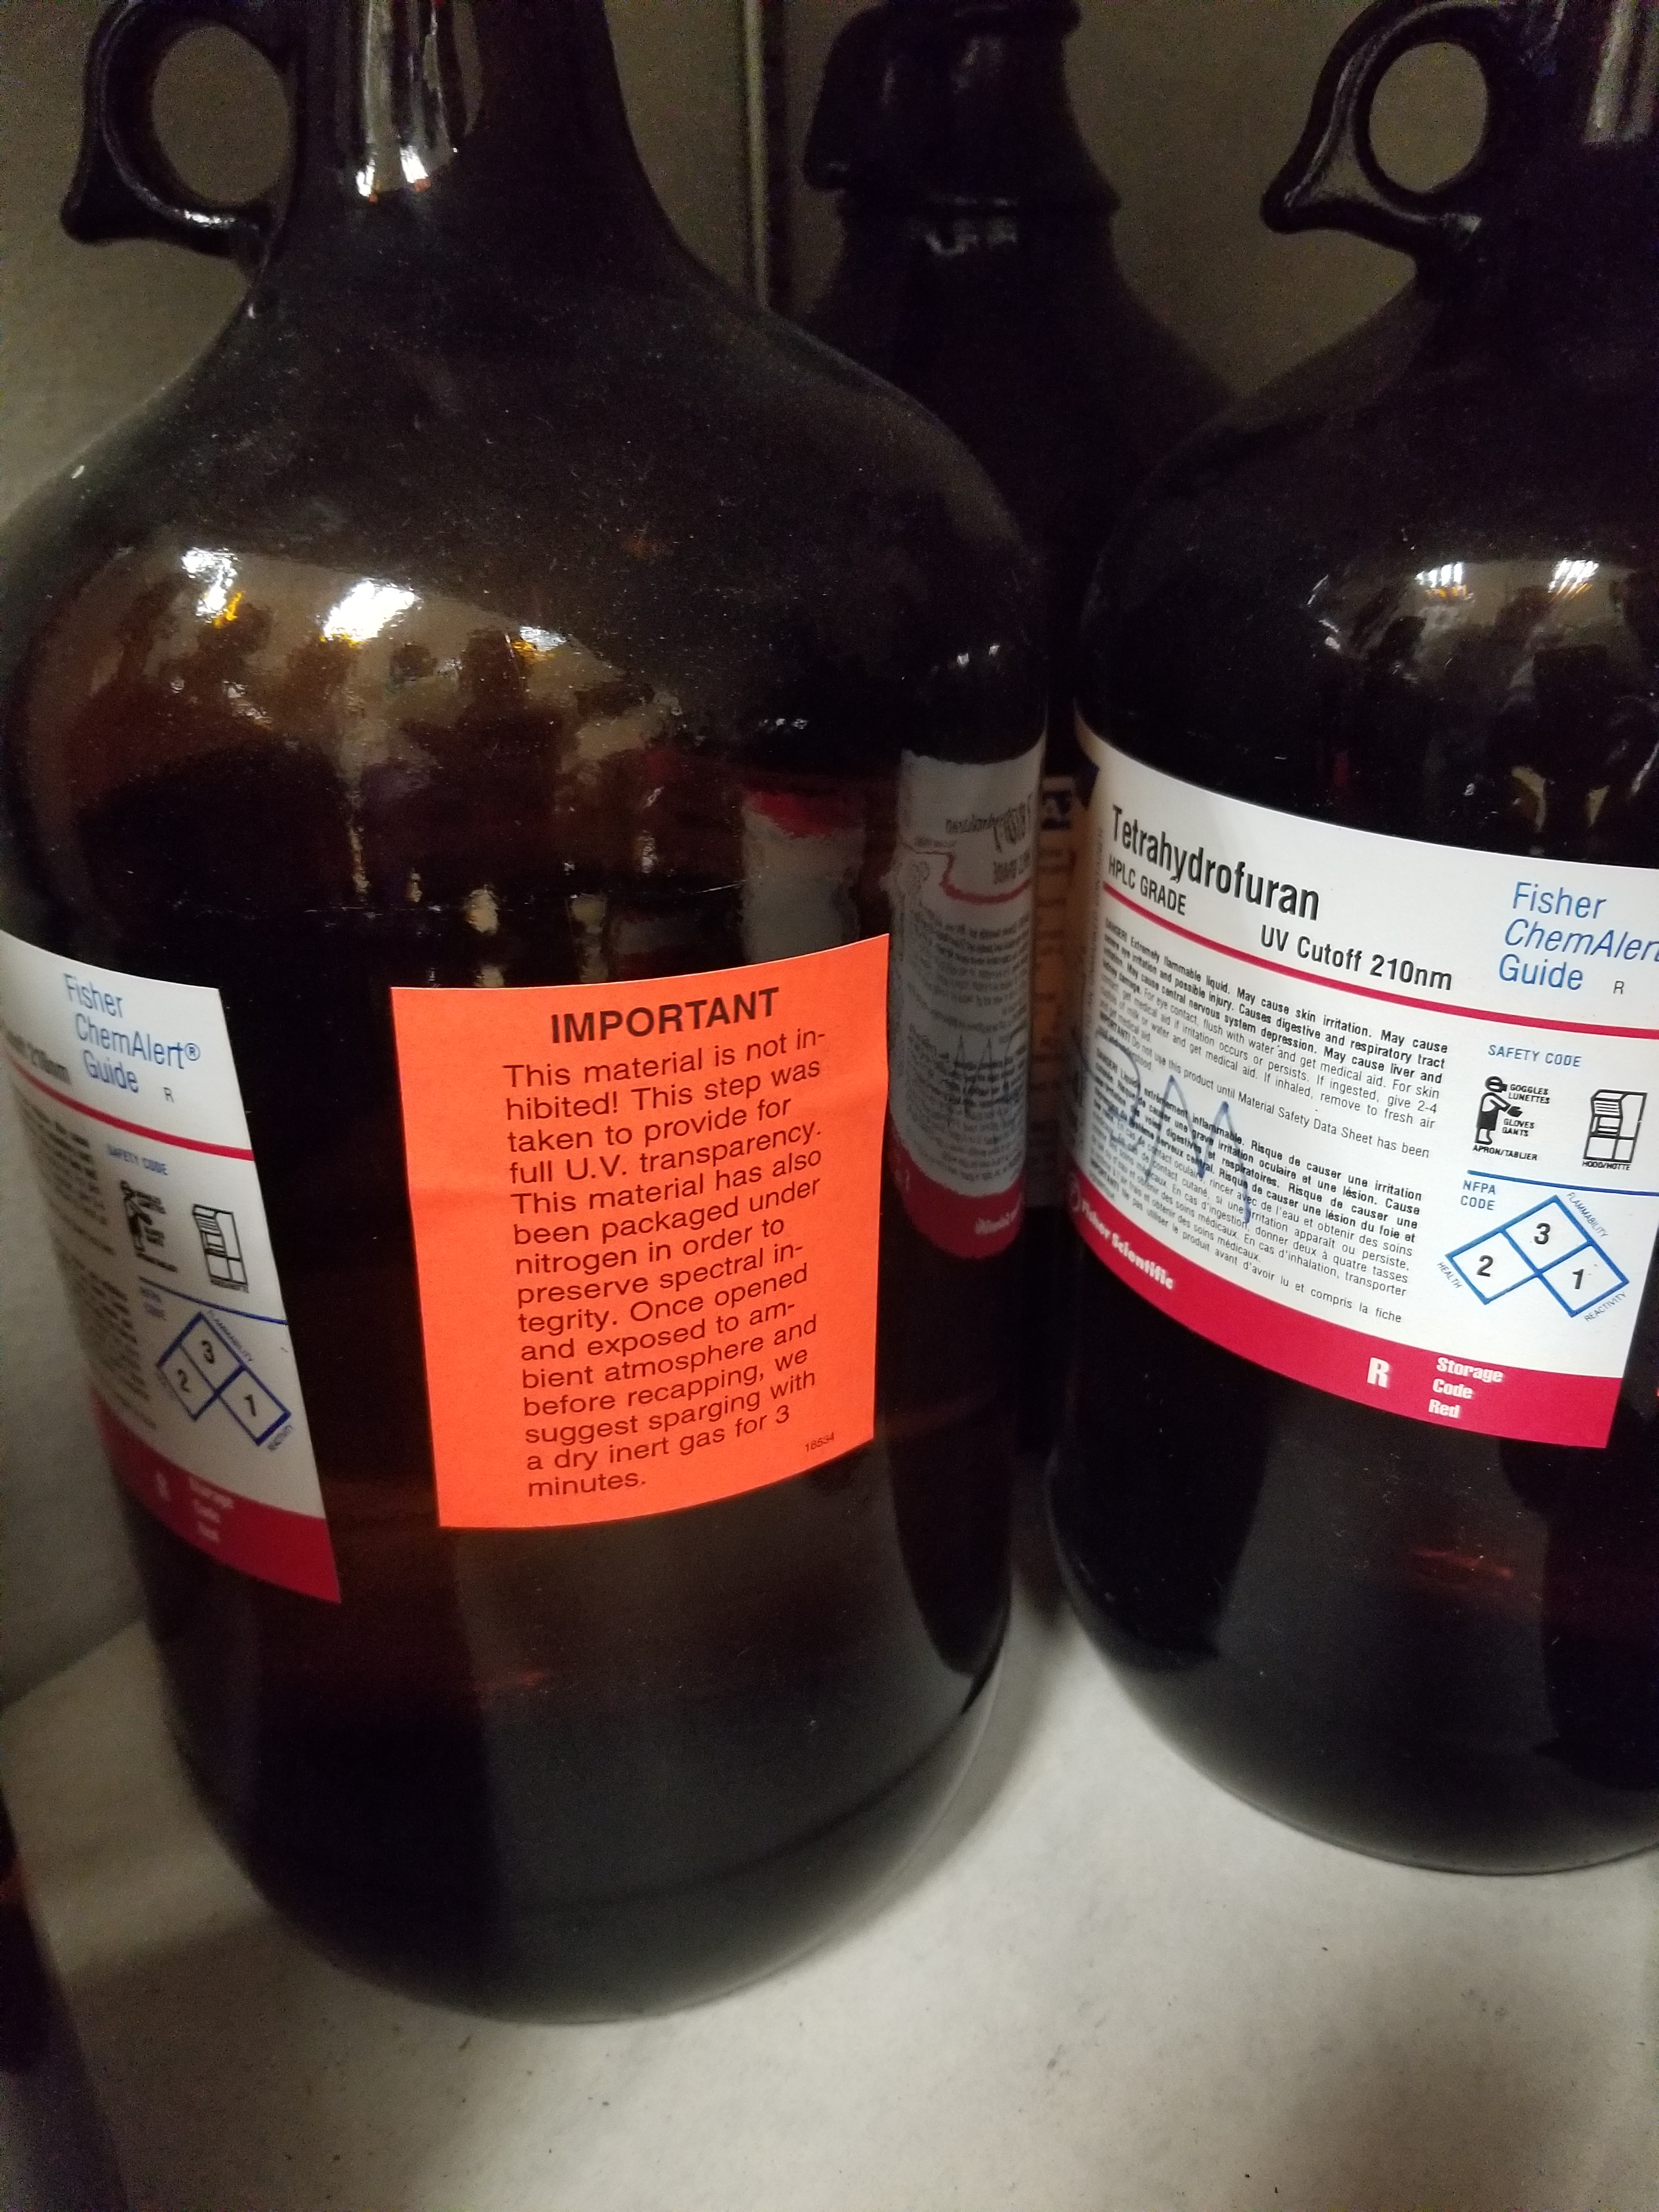
Time-sensitive chemicals – Waste Costs
Aged containers of Time-Sensitive chemicals can be very costly to dispose of as vendors must stabilize them and apply additional safety measures for handling and transportation.
Recent examples at Tulane:
$2500 for a single bottle of old Diethyl Ether
$12,000 for cleanout of 24 bottles of old (some >18 years) solvents, including a bottle of Isopropyl Ether

Slide 11
Institutional response to managing time-sensitive chemicals
Time-Sensitive Chemicals have become a recognized safety issue at all research institutions.
EHS departments have responded by creating programs that reduce the time these chemicals remain stored on campus.
OEHS has chosen Maximum Storage Time limits for each category of time-sensitives that are similar to limits in place at peer institutions.
The goal is to reduce the chance of a chemical incident at Tulane and control waste disposal costs.

Slide 12
types of time-sensitive chemicals
Peroxide Forming Chemicals
Many compounds, including common solvents
Other Time-Sensitives
Picric Acid
Alkali Metals/Metal Amides
Anhydrous Hydrogen Halide Gas Cylinders
Chloroform
Nitric Acid in HDPE Bottles
Formic Acid
Hydrogen Peroxide

Slide 13
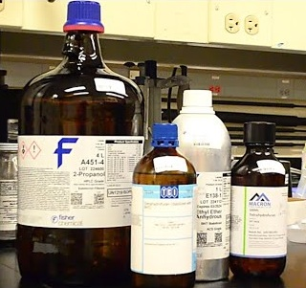
Peroxide-Formers
React with atmospheric oxygen and light to undergo autoxidation or peroxidation
Produce explosive Organic Peroxides that accumulate over time
Safe use requires appropriate storage, inventory tracking, and regular testing of containers

Slide 14
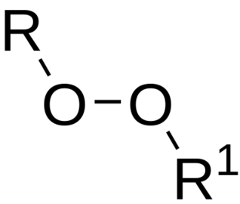
Organic peroxides
Contain a (R−O−O−R′) Peroxide Functional Group.
If R’ is Hydrogen, the compound is called a Hydroperoxide.
The O-O bond easily breaks, producing free radicals.
When concentrated, can self oxidize
Potential for Explosive Decomposition

Slide 15
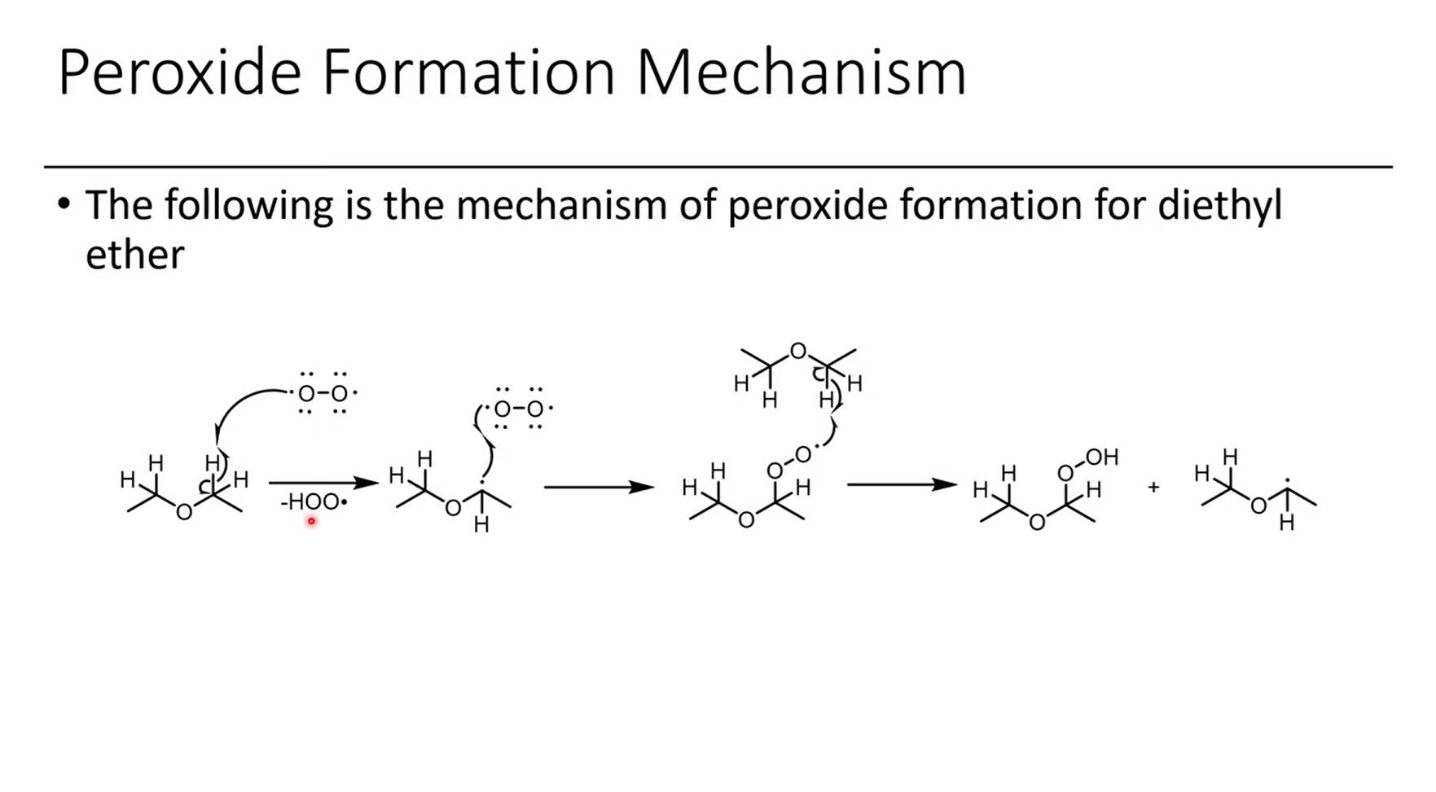
How do peroxides form? (Diethyl ether example)
Oxygen reacts with ether, removing a hydrogen to form a hydroperoxyl radical (aka hydrogen superoxide, which goes on to react further)
Ether radical reacts with more oxygen, forming a peroxyl radical that can abstract a hydrogen from another ether molecule.
Products are Diethyl Ether Hydroperoxide, as well as the Hydrogen Superoxide and Diethyl Ether with a radical that can both further react.
1.
2.
3.
Continues in a Chain Reaction…
Notes:
Diagram taken from a video lecture by That Chemist on youtube: https://www.youtube.com/watch?v=D8tktdPSIso

Slide 16
Classes of Peroxide-Forming Chemicals
Grouped into 4 Classes based on mechanism or potential to form Organic Peroxides:
Class A – Form explosive levels of peroxides without concentration.
Class B - Form explosive levels of peroxides when distilled, evaporated or otherwise concentrated.
Class C – Violently auto-polymerize after internal peroxide accumulation from auto-oxidation.
Class D - May form peroxides but cannot be clearly categorized in Class A, B, or C.

Slide 17
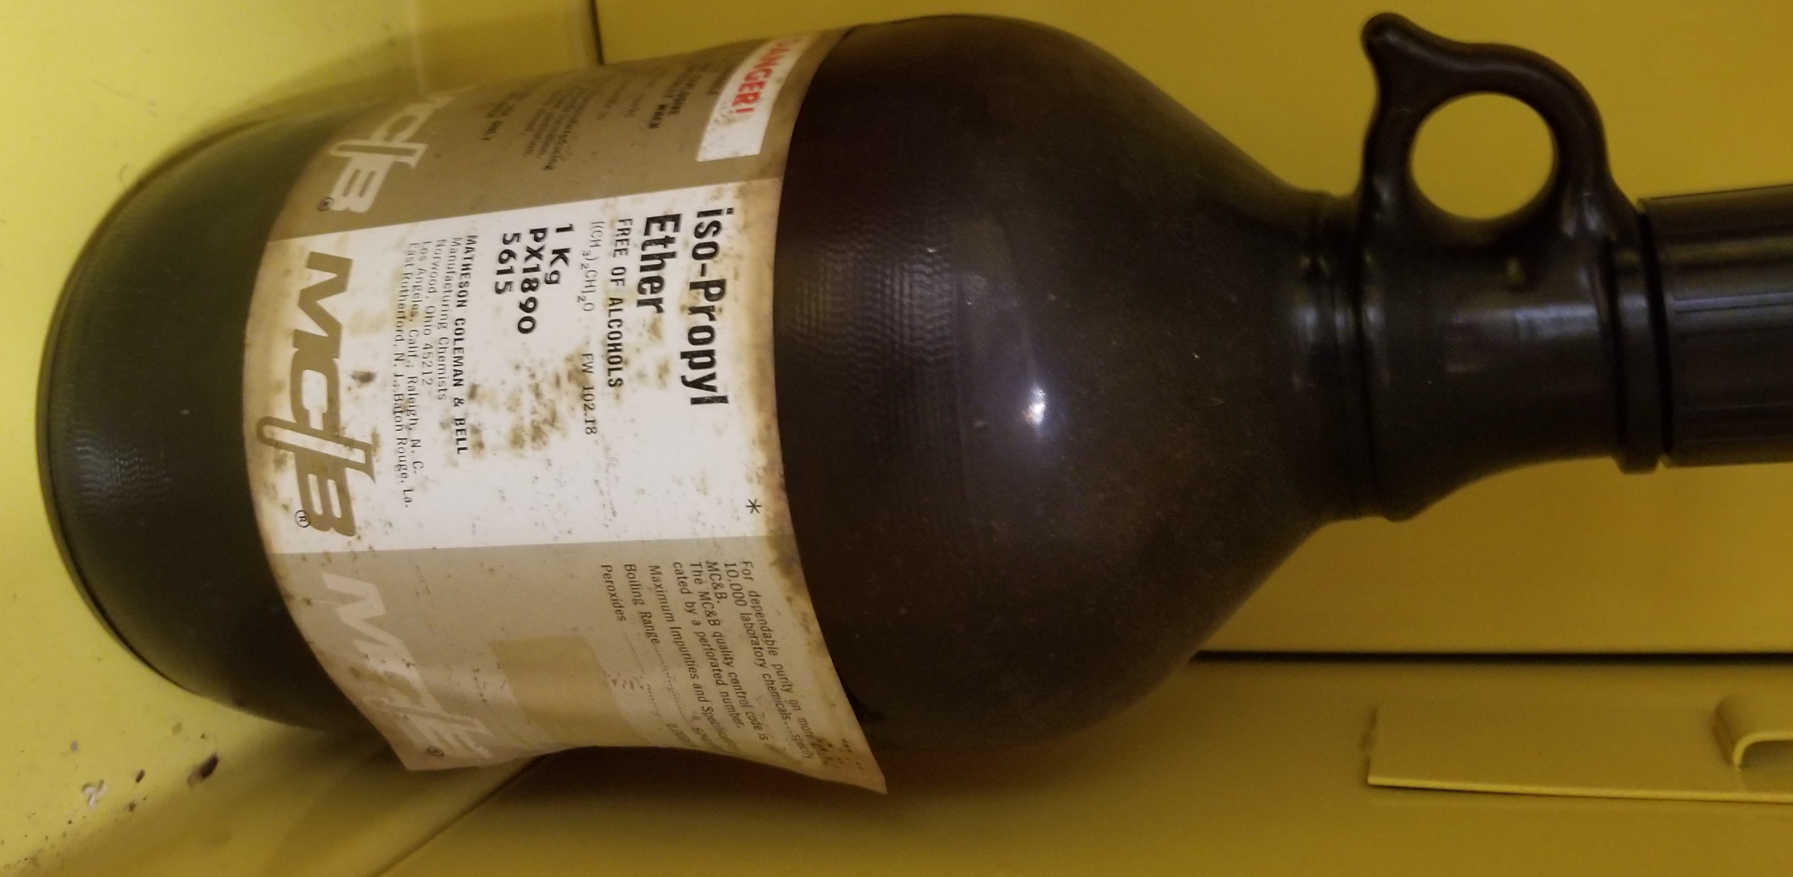
Peroxide formers - Class a
Moste Severe Peroxide Hazard
Form explosive levels of peroxides without concentration
Substitute other solvents whenever possible!
Isopropyl Ether
Butadiene (liquid monomer)
Chloroprene (liquid monomer)
Divinylacetylene
Divinyl ether
Tetrafluoroethylene
Vinylidene Chloride
Test or dispose within 3 months of purchase. Dispose of unopened containers after 12 months.

Slide 18
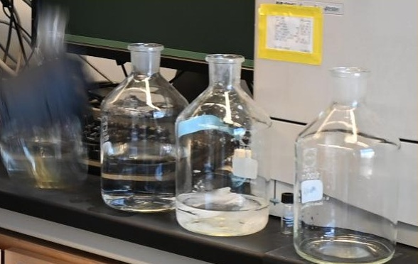
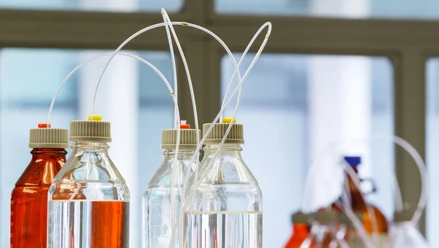
Peroxide formers - Class B
Includes many common lab solvents
Tetrahydrofuran (THF)
Several Ethers
2-Butanol
Isopropanol
Evaporation or Distillation increase Peroxide concentration.
Test every 6 months and prior to use. Do not concentrate if peroxides are present.
Manage secondary containers as well, such as HPLC bottles.
Dispose if Peroxides >10ppm. Dispose of unopened containers after 18 months.

Slide 19
Peroxide formers - Class C
Auto-peroxidation results in sudden, energetic polymerization
Especially dangerous when uninhibited—store only in the stabilized form.
Examples:
Chlorotrifluoroethylene
Chlorobutadiene
Styrene
Vinyl Compounds
Dispose if Peroxides >10ppm. Dispose of unopened containers after 18 months.
Uninhibited: Dispose after 24 hours.

Slide 20
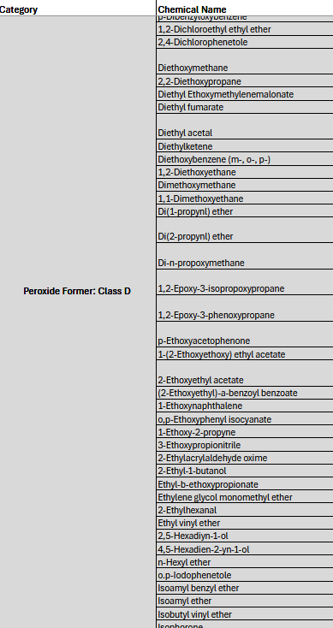
Peroxide formers - Class D
Compounds that, based on chemical structure, are predicted to form peroxides.
No clear evidence of level of hazard
Over 100 compounds, see full list linked on the OEHS Time-Sensitive Chemicals Webpage
Dispose if Peroxides >10ppm. Dispose of unopened containers after 18 months.

Slide 21
Other time-sensitive chemicals (besides peroxide-formers)
Picric Acid
Alkali Metals/Metal Amides
Anhydrous Hydrogen Halide Cylinders
Chloroform
Nitric Acid in HDPE Bottles
Formic Acid
Hydrogen Peroxide

Slide 22
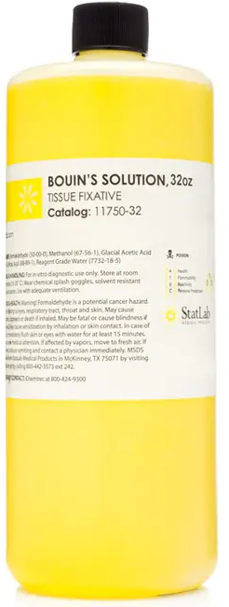
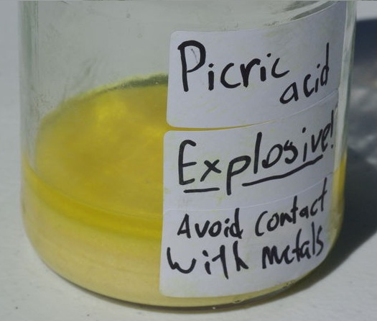
Picric acid (Trinitrophenol)
Sold as Picric Acid moistened with Water or in a solution (Bouin’s Solution) used as a histology stain
Fully dry Picric Acid is a highly unstable, shock-sensitive explosive!
Must be inspected at least quarterly and liquid added to prevent drying out
Forms explosive Metal Picrates when in contact with many metals (including metal spatulas or container caps)
Dispose 2 years after purchase.

Slide 23
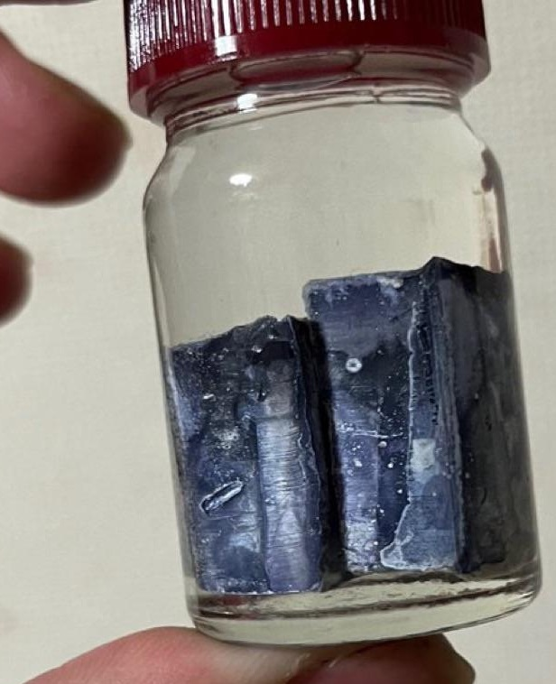
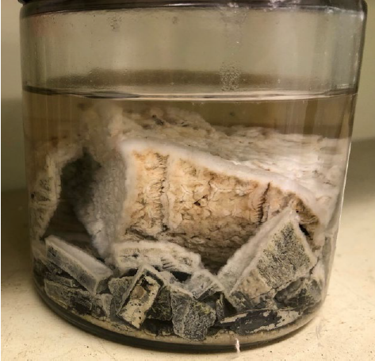
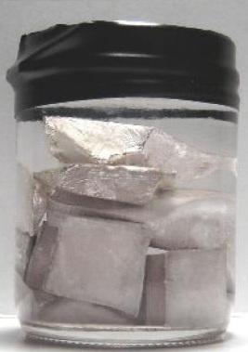
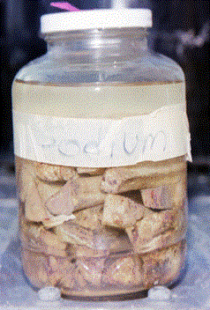
Alkali metals (Na, K)
Slowly react with oxygen to form oxides and superoxides
Oxygen can dissolve into mineral oil and react, forming a coating or ”fuzz” of Oxide or Superoxide
These coatings can explode or ignite upon cutting
Inspect for color/coating changes before use
Dispose when expired or develops discoloration or fuzzy coating.
Fresh Potassium
Potassium with “Fuzz”
Fresh Sodium
Sodium Superoxide Spots

Slide 24
metal amides
Includes Potassium Amide and Sodium Amide.
Sometimes categorized as Peroxide Formers but do not generate organic peroxides.
Highly reactive, combustible solids
Form explosive nitrite and hyponitrite in the presence of oxygen.
Always store in a glove box under an inert atmosphere.
Testing or inspecting is not practical.
Dispose 1 year after opening or 2 years after purchase, whichever comes first.

Slide 25
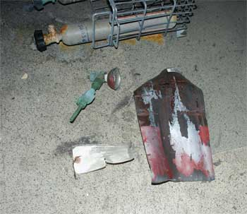
Anhydrous halogen halide gas cylinders
Compressed gasses including Hydrogen Fluoride, Sulfide, Chloride, Bromide, and Cyanide
Moisture can enter the cylinder, initiating corrosion that weakens the cylinder and produces Hydrogen gas.
Pressure rises as the cylinder weakens, ultimately failing and creating dangerous projectiles and releasing hazardous gases.
Check for rising pressure!
Dispose when expired or after 2 years, whichever is shorter.
Anhydrous Hydrogen Fluoride Cylinder Failure

Slide 26
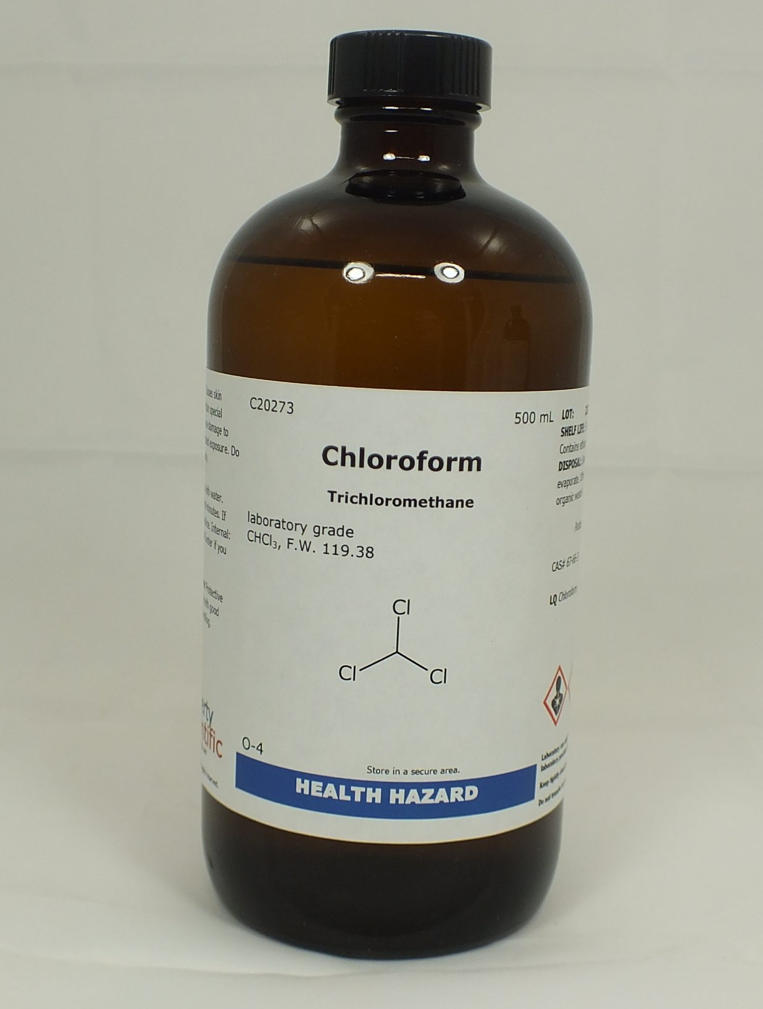
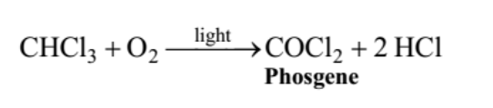
chloroform
When exposed to air and light, degrades to form Phosgene, a highly toxic gas
Store in amber bottles away from light
Purchase Chloroform stabilized with ethanol
Dispose 12 months after opening or after 3 years if unopened.
Unstabilized: Dispose after 12 months.

Slide 27
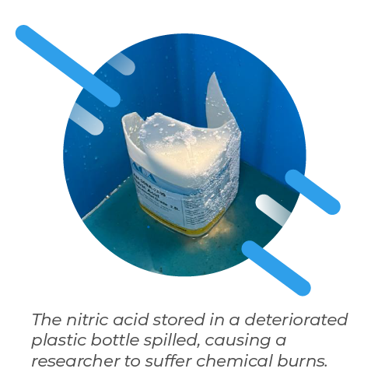
Nitric acid in hdpe bottles
Nitric acid is a strong oxidizer
Sold in Glass or High-Density Polyethylene (HDPE) containers
Degrades HDPE containers over time, especially at concentrations > 50%
Embrittlement and eventual failure of the container
Container failure risks leaks or plashes of corrosive liquid and toxic fumes
Dispose after 2 years.
Notes:
Pictured: Photo from Hong Kong Polytechnic University spill:
https://www.polyu.edu.hk/hso/news-and-events/newsletters/2025-01/preventing-chemical-spills/
Other reported Nitric Acid container failures in labs:
UT Texas – Austin reported 2 Nitric Acid container failures occurring in 2019 and 2021:
https://ehs.utexas.edu/sites/default/files/Nitric-Acid-Container-Failure-2021.pdf
U of Florida reported a Nitric Acid container failure in 2022:
https://www.ehs.ufl.edu/wp-content/uploads/2025/06/LL_Nitric_Acid.pdf

Slide 28
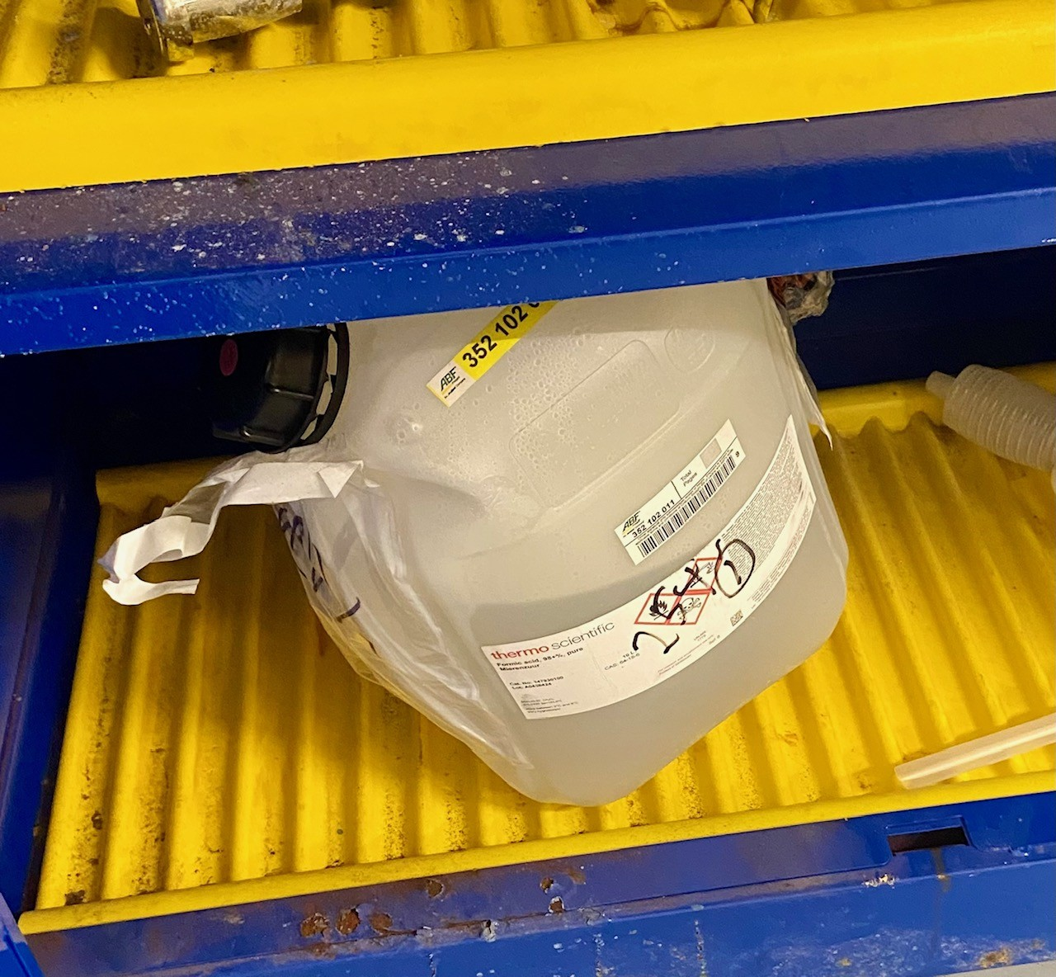
Formic acid and hydrogen peroxide
Some chemicals produce gas when they degrade, building up pressure in unvented containers
Formic Acid (>90%)
Hydrogen Peroxide(>30%)
Could rupture, causing a splash or chemical spill
Store in vented containers or vent at least every 12 months.
Formic Acid: Dispose when expired.
Hydrogen Peroxide: Dispose after 1 year or when expired.
Concentrated Formic Acid pressurizing an unvented container.

Slide 29
OEHS Time-sensitive Chemicals Program
To minimize the possibility of an incident at Tulane, OEHS has developed a set of rules for management of these chemicals.
These rules are similar to policies at peer institutions and were developed after consulting with other academic EHS departments.
Managed Properly
Lab follows required practices
OEHS will absorb cost of container disposal
*not including compressed gas cylinders
Mismanagement
Practices are not followed
The PI or department are responsible for the cost of disposal, which can be substantial.

Slide 30

OEHS Time-sensitive Chemicals Program
Requirements for:
Purchasing and Inventory
Storage
Labeling
Container Inspection and Testing
Timely Disposal
Annual Lab Inspections

Slide 31
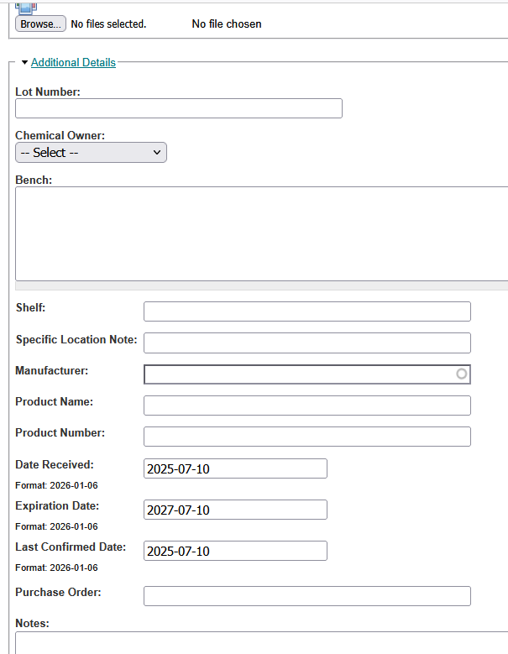
Purchasing and inventory
Purchase with inhibitor whenever possible
Purchase minimum amounts needed
Record ALL containers in SciShield Inventory with:
Date Received
Expiration Date (or Maximum Storage Time)
Bench, Shelf, or Specific Location Note

Slide 32
Maximum Recommended storage time - Peroxide Formers
Category | Maximum Storage Time | Testing Frequency
Class A (opened) | Dispose 3 months after opening | Before use
Class A (unopened) | Dispose 12 months after purchase | When opened
Class B (opened) | Dispose if testing shows >10ppm peroxides | Before Distillation/Concentration and every 6 months
Class B (unopened) | Dispose 18 months after purchase | When opened
Class C (stabilized) | Same as Class B | Same as Class B
Class C (unstabilized) | Within 24 hours of opening | Before use
Class D | Same as Class B | Same as Class B

Slide 33
Maximum Recommended storage time – Other Time-Sensitives
Category | Maximum Storage Time | Inspection Frequency
Picric Acid | 2 years. | Must be kept wet. Inspect quarterly and add liquid.
Anhydrous Hydrogen Halide Gas Cylinders | 2 years or when expired. | Regularly check if cylinder pressure is rising.
Alkali Metals | Dispose when expired, discolored, or forms a crust. | Before use.
Alkali-Metal Amides | 1 year after opening Unopened: After 2 years | Hazard is not visible.
Chloroform (stabilized w EtOH) | 1 year after opening. Unopened: After 3 years. | Hazard is not visible.
Chloroform (unstabilized) | 1 year. | Hazard is not visible.
Nitric Acid in HDPE | 2 years. | Before use.
Formic Acid | When expired. | Vent every 12 months.
Hydrogen Peroxide | 1 year or when expired. | Vent regularly.

Slide 34
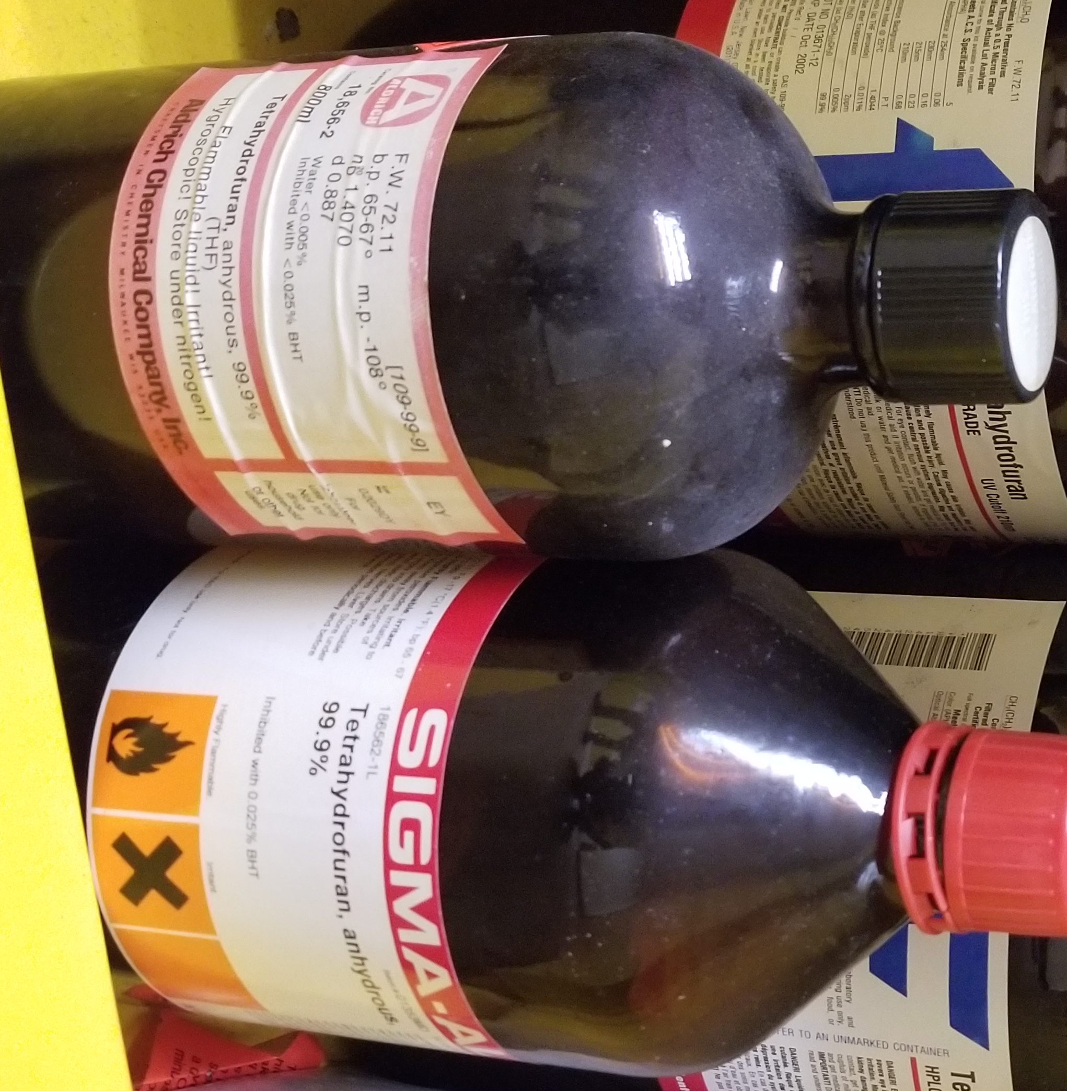
Peroxide formers - Storage
To keep better track of chemicals, store all containers of the same compound together
Use up the oldest containers first
Store in the dark
Use amber bottles, not clear
Wipe cap threads clean after use
Use up old bottles before purchasing new ones.

Slide 35
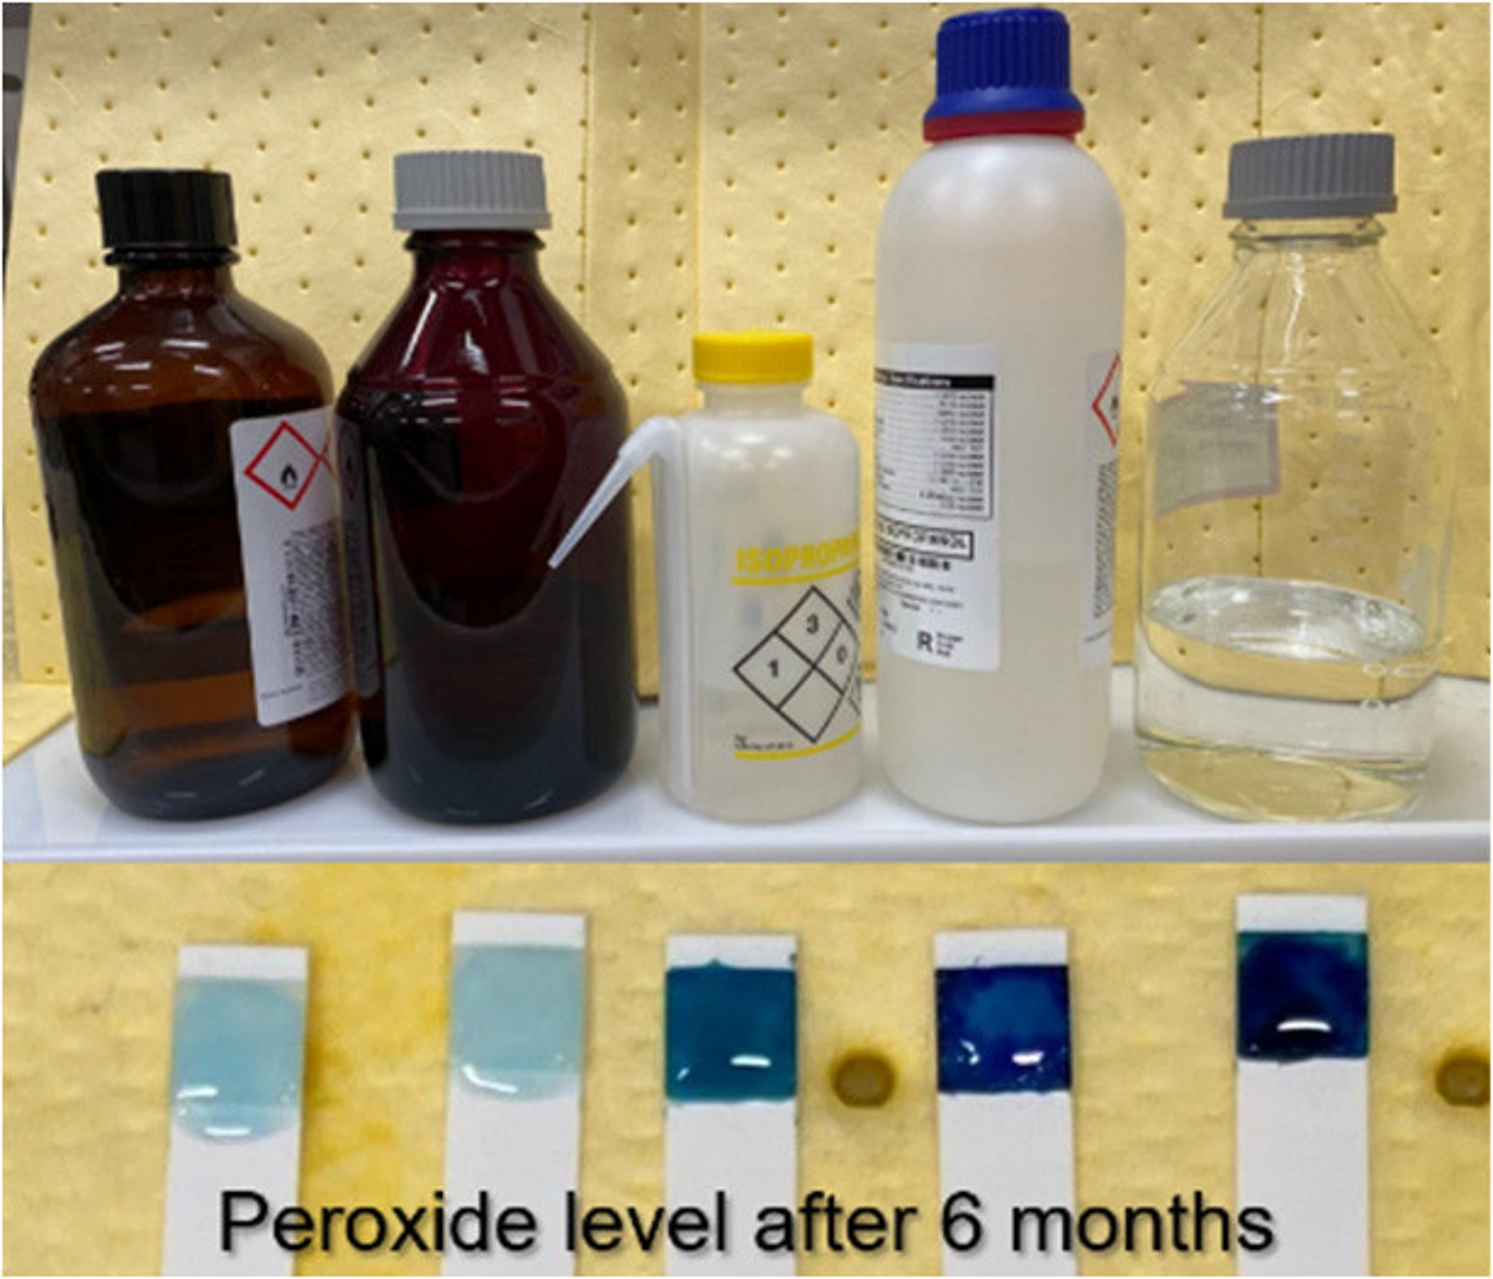
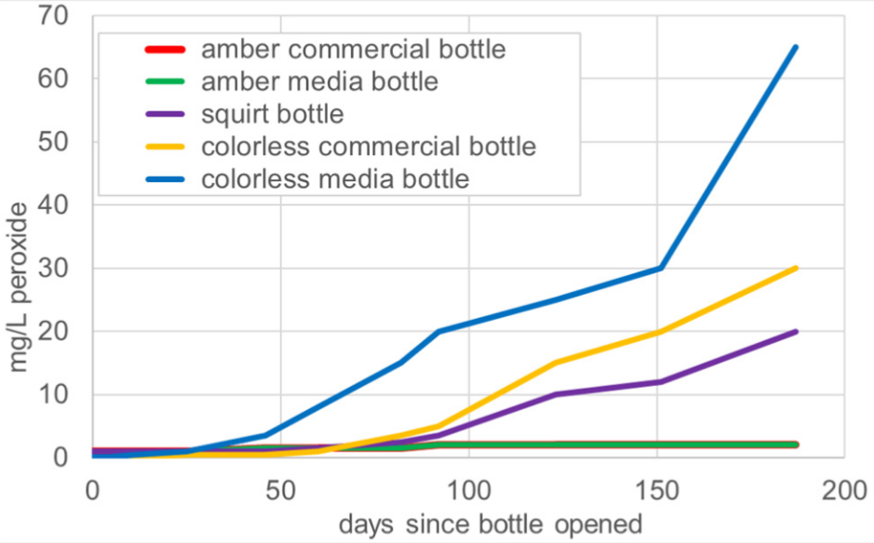
Peroxide formers – Store in amber bottles
Isopropanol in various containers were exposed to constant light for 6 months and peroxide levels measured.
Organic Process Research & Development
2022 26 (6), 1558-1561
Notes:
https://pubs.acs.org/doi/10.1021/acs.oprd.2c00112

Slide 36
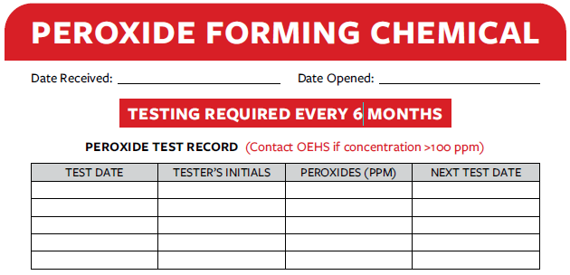
Peroxide formers - labeling
Apply and fill out a Peroxide-Forming Chemical Label for each container
Test and dispose of containers on schedule
Use calendar reminders to track due dates
OEHS Peroxide Forming Chemical Label – Must be present and filled out for EVERY CONTAINER of Peroxide Former
Label Template Available on OEHS Website:
Main Page➔Research and Laboratory Safety➔Labels

Slide 37
Inspection of time-sensitive containers
Containers MUST be regularly inspected by the lab
Careful visual inspection without moving or disturbing the container
Shine a flashlight through dark or amber bottles to more easily see precipitates.
Follow the specific instructions for each type of Time-sensitive Chemical.
If the container passes inspection, it can be picked up and used or tested.

Slide 38
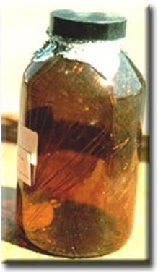
Failed Inspection of Peroxide-Forming Chemicals
If you see any of the following, DO NOT MOVE the container. Contact OEHS immediately:
Visible crystals or solid precipitate in the liquid
Very fine, spun glass-wool appearance in the liquid
Incrustation around the cap
Layer separation (an oily viscous layer)
Visible discoloration or Cloudiness
Very old container (yellowed label or made by a manufacturer from many years ago)
Visible Peroxide crystals in a solvent.

Slide 39
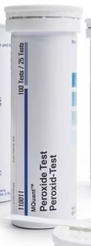
Testing for organic Peroxides
After passing a visual inspection, use test strips to measure peroxide levels.
Record the test result on the container using a Peroxide Former Label.
Use test strips with a range of detection of at least 0-100ppm.
OEHS recommends peroxide test strips such as MQuant (Sigma-Aldrich)
Not provided by OEHS
Carefully read the manufacturer instructions as the process is different for solvents than for aqueous solutions.
Notes:
Costs $60 for 100 test strips.

Slide 40
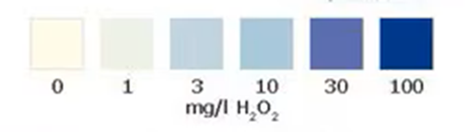
Testing for organic Peroxides
If the tested concentration of peroxides is:
≤10ppm – Update the label with testing date and value.
>10ppm – Request pickup as waste within 2 weeks. Include the peroxide test date and value in the request.
≥100ppm - DO NOT MOVE the container. Contact OEHS immediately.
MQuant test strips color guide

Slide 41
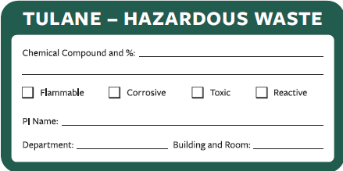
Disposal of time-sensitive Chemicals
Promptly request disposal when:
Expired
Exceed maximum storage time
Peroxide levels >10ppm
Do not mix with other wastes
Peroxide Formers must be tested within 2 weeks of request.
In addition to information normally included in pickup requests, additionally include the test date and peroxide value.
To request the pickup, email HazWaste@tulane.edu
*OEHS does not dispose of gas cylinders

Slide 42
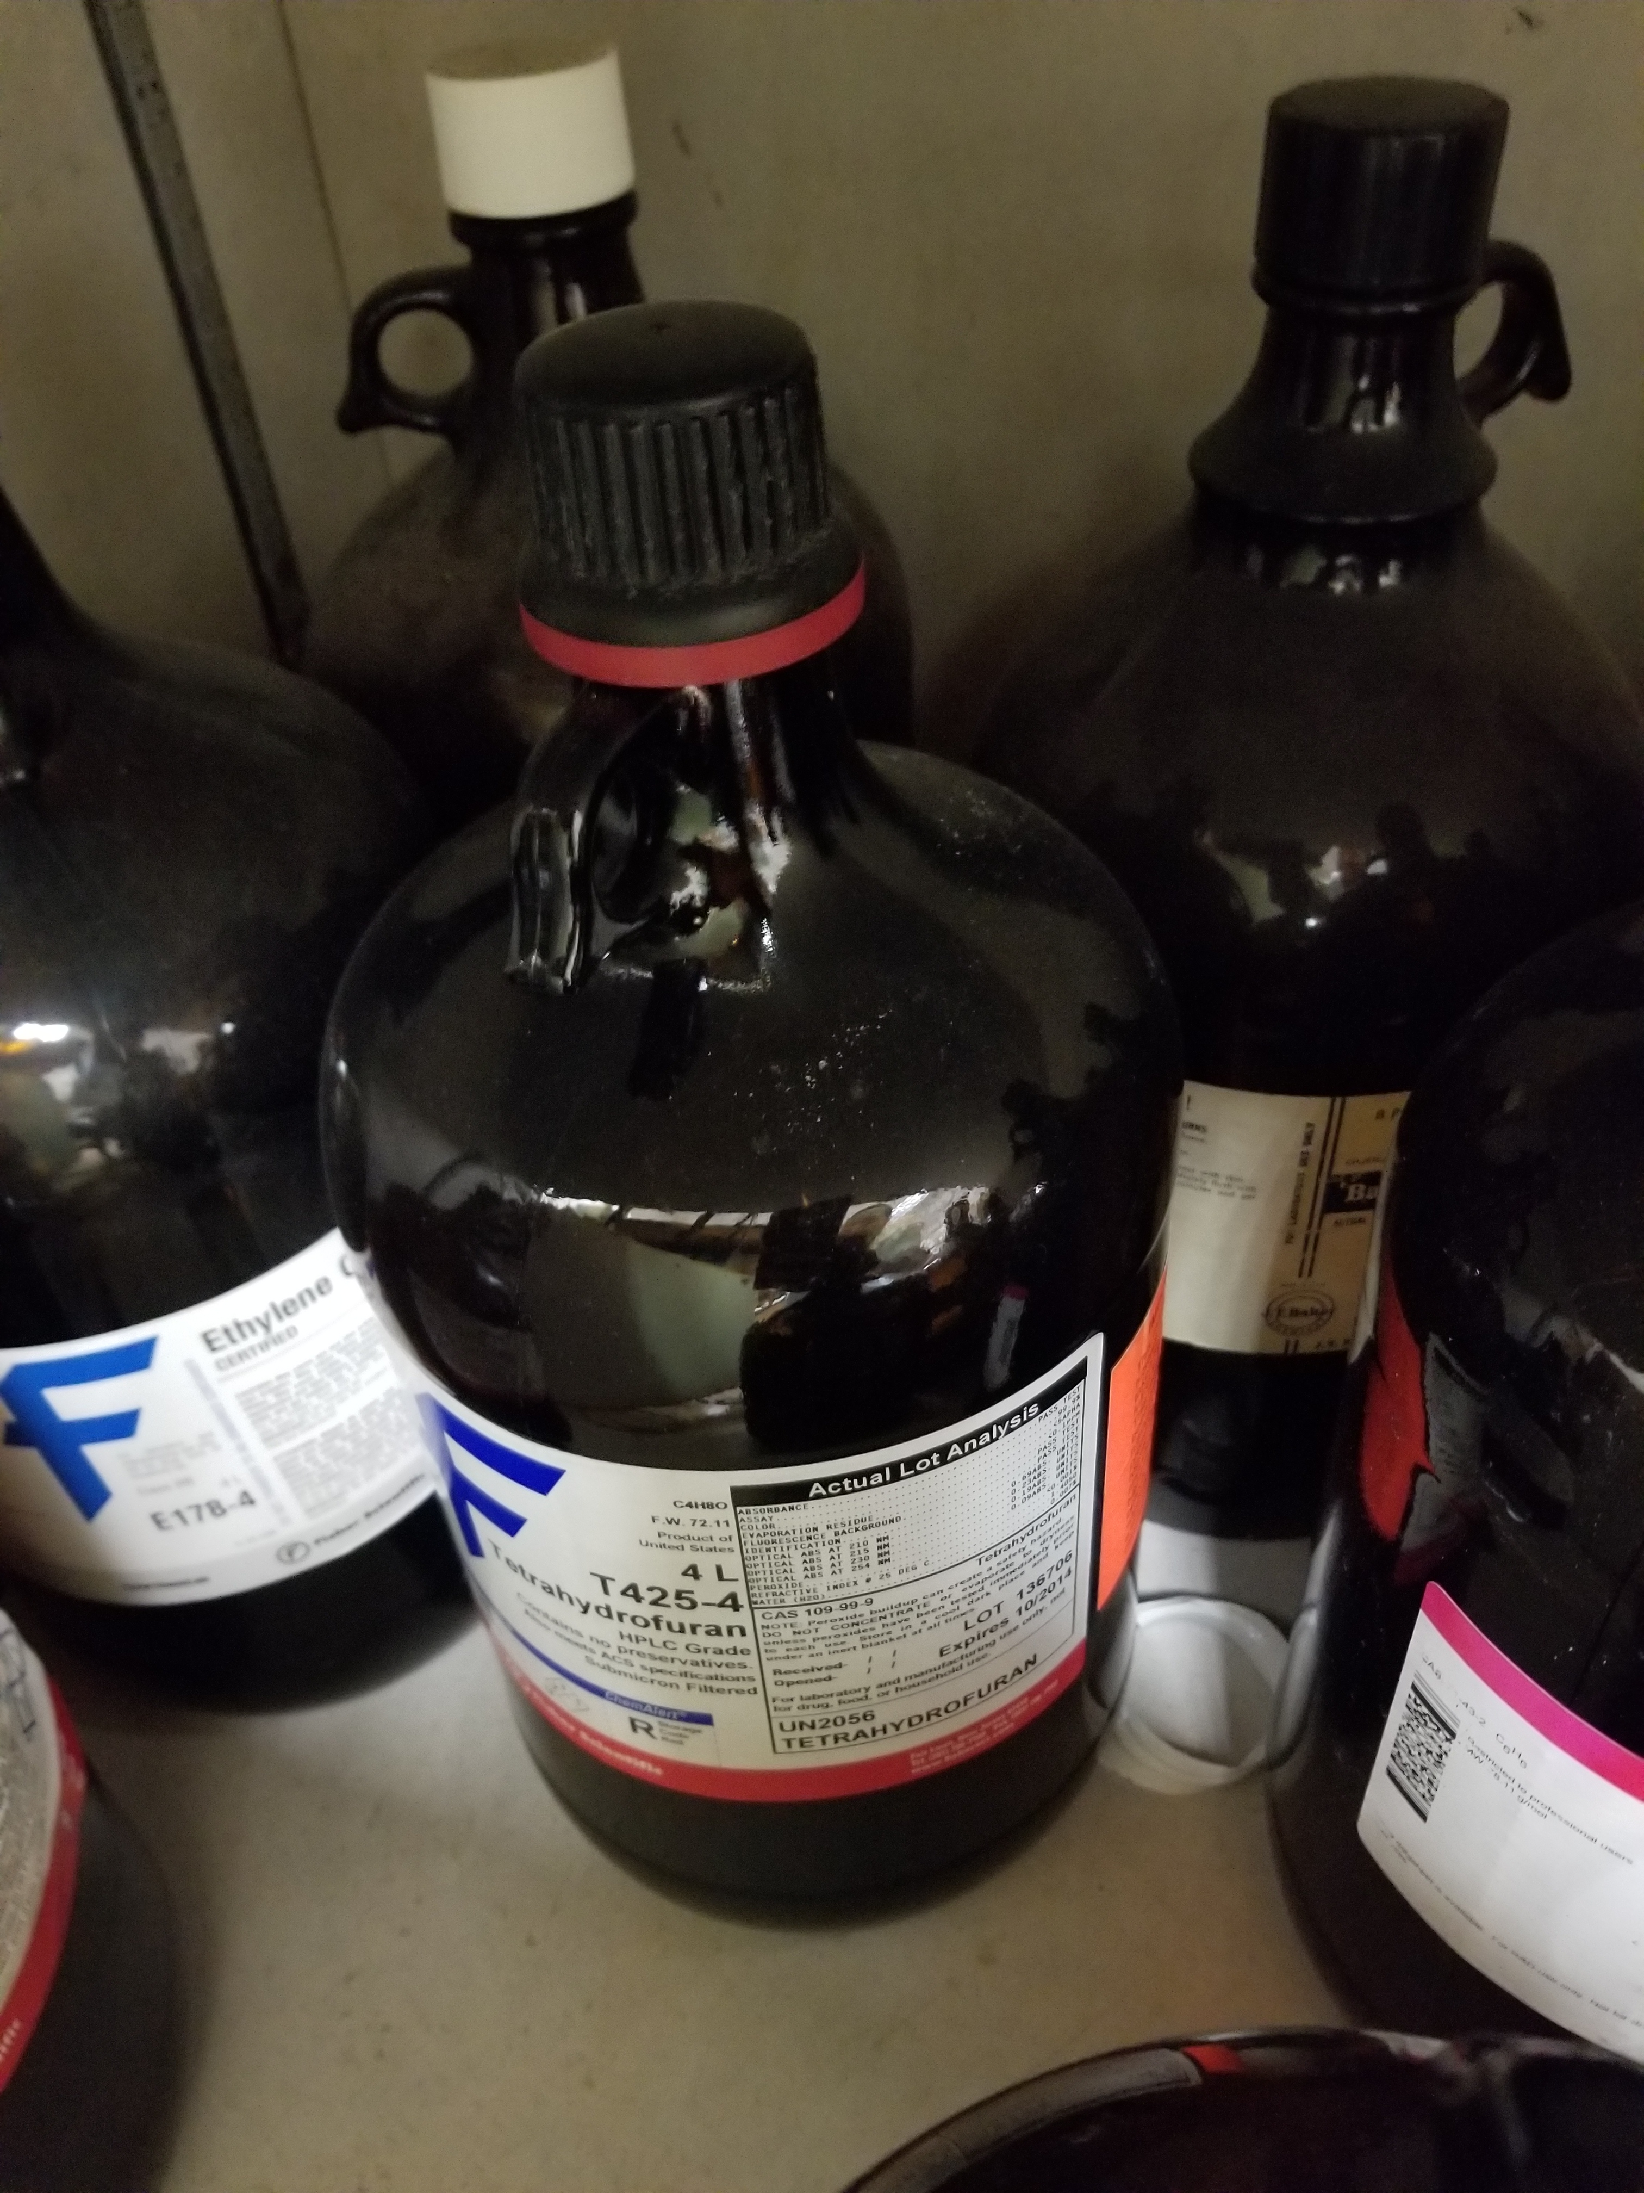
REHOMING OF time-sensitive Chemicals IS NOT ALLOWED
When a lab is decommissioned or taken over by a new PI, rehoming of good quality chemicals is generally encouraged to reduce waste
Time-Sensitive Chemicals are the exception. They must be disposed of prior to the PI leaving or lab activity ending.
Do not turn over to other PIs or Lab groups.

Slide 43

Annual oehs lab inspections
Tulane Labs are inspected annually and identified Safety Issues must be corrected by the lab.
Potential Time-Sensitive Chemical Findings Include:
Inaccurate Chemical Inventory
Inventory Reconciliation Missing
Time-sensitives are expired or over maximum storage time
Missing or incomplete Peroxide-Former Labels
Peroxide testing is overdue/missing from labels

Slide 44
Time-sensitive chemicals resources
OEHS Webpage:
OEHS Home➔Research and Laboratory Safety➔Time-Sensitive Chemicals
OEHS.tulane.edu/time-sensitive-chemicals
Fact Sheet:
You received today as a printout, also linked on the webpage.
Time-Sensitive Chemicals Table:
Full list of these compounds. Linked on the webpage.

Slide 45
Action items to comply with the program
When you get back to your lab:
Identify all Time-Sensitives.
Inspect the containers.
Ensure storage is good with Peroxide Formers in a dark location.
Add or update labels if they are missing.
Test/inspect any containers that are overdue.
Update inventory. Are all your containers listed with dates and locations?
Request disposal if needed.

Slide 46
Tulane Office of Environmental Health and Safety
OEHS@tulane.edu
Questions?
Marcel Charbonnet, Lab Safety Manager
mcharbo@tulane.edu
Haylie Tucker, Lab Inspections Manager
htucker@tulane.edu

