Slide 1
OEHS Bio Lab Training
Office of Environmental Health & Safety
Tulane University
OEHS@Tulane.edu
oehs.tulane.edu
Notes:
This is a supplementary training to the 90 minute OEHS Lab Safety Training. It is intended for anyone working in a lab with Needles, Blood, Tissues, Formaldehyde, or needing to wear a Respirator or N95 Face Mask for work. All of those work activities require annual training covered in this course.

Slide 2
Training Modules at Tulane
Faculty and Staff:
TULearn
Students:
Canvas
Mandatory Annual:
-Emergency and Fire Prep
-Emergency Action Plans
-Portable Fire Extinguishers
-Hazard Communication
-Blood Borne Pathogens
-Formaldehyde Safety
-PPE (Respirators)
Others based on Job:
-Take on Start
-Determined by Supervisor
Notes:
Tulane uses 2 platforms to provide training modules. Canvas for Students, Bridge for Faculty and Staff. Both are accessible via Gibson Online. Training requirements are a combination of mandatory annual training for everyone and specific training based on job hazards. Check the “Training” page of the OEHS website for details.

Slide 3
Today’s Training
Covers:
-Blood Borne Pathogens
-Formaldehyde Safety
-PPE (Respirators)
Approx 30 min
Link to quiz at end
Credit in Canvas or TULearn
Notes:
This is a combined training course developed by OEHS to cover the content needed by lab workers. The intent is to save time, put all the content in one course, and focus on content specific to Tulane.

Slide 4

AGENDA
Blood Borne Pathogens
Formaldehyde
Respirators
Notes:
The agenda. Blood Borne Pathogens (BBP) training is needed by any worker who will be handling needles or working with BBP’s.

Slide 5

What are Bloodborne Pathogens?
Infectious microorganisms in Blood
Can cause disease in humans
Sometimes found in:
Other body fluids
Non-human Primate research animals
Notes:
This is OSHA’s definition of BBPs.

Slide 6
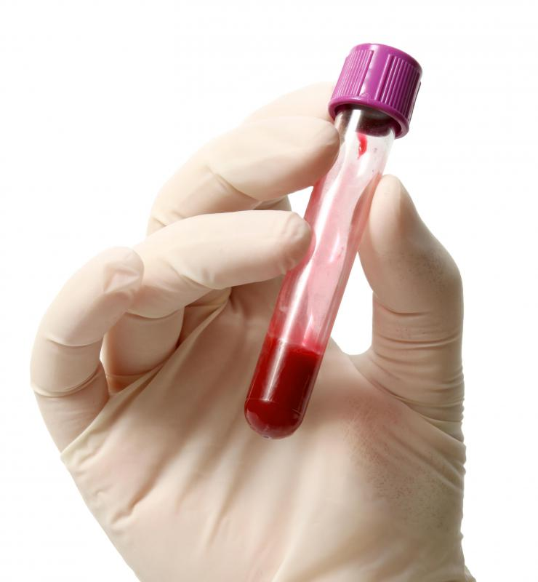
Blood and OPIM
Blood
Blood components
Products made from blood
Other Potentially Infectious Materials
Body fluids
Unfixed tissues or organs
Notes:
OSHA definitions of materials that fall under the BBP’s rules.

Slide 7

The Rule of Thumb
All blood and body fluids should be treated as infectious!
Notes:
These materials can never be assumed to be completely clean and safe. Always treat them as though they were infectious, even if you think they might not be.

Slide 8
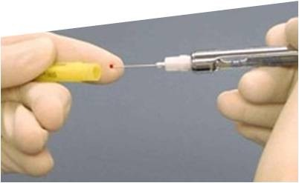
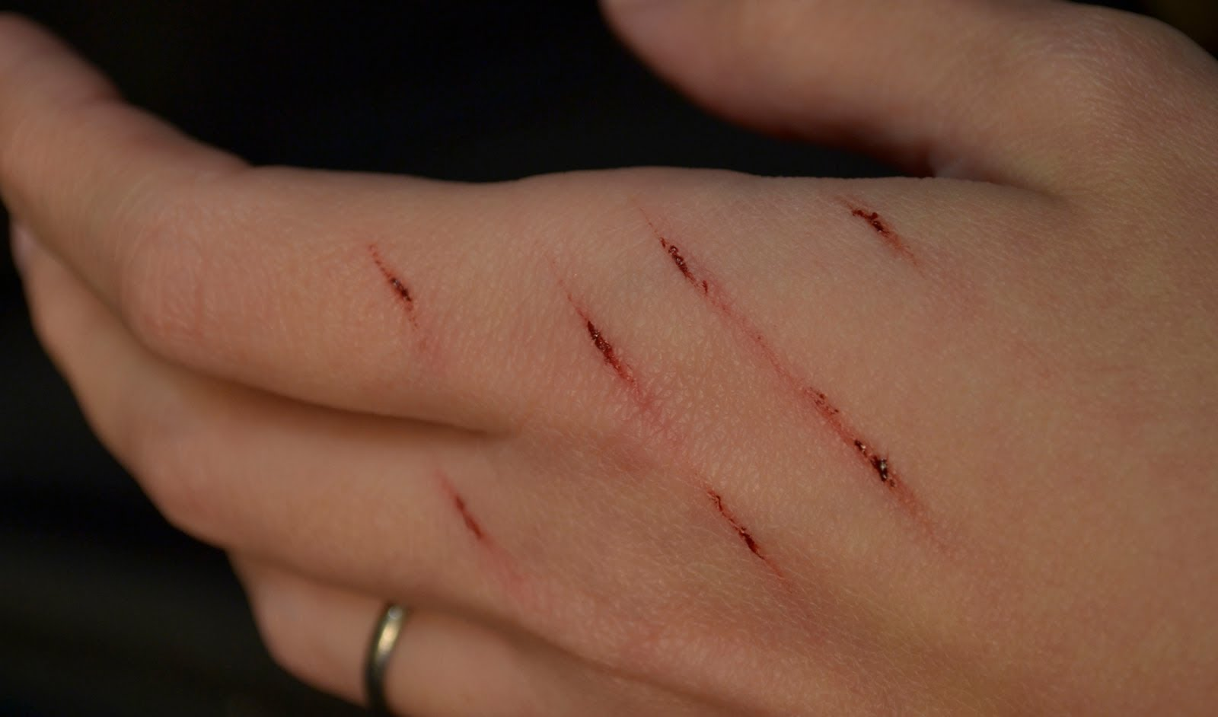
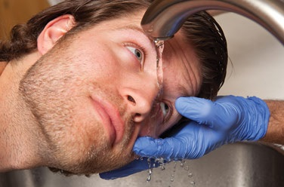
Modes of Transmission
Needlestick
Cut, Bite, Abrasion
Eye or Mouth Splash
Notes:
Primary routes of exposure for BBP’s.

Slide 9

Most Common BBPs
HIV
Viral Hepatitus
*B Virus
Many others:
Malaria
Syphilis
Notes:
There are too many BBPs to cover in this training. HIV and Hepatitus are representative of BBP’s. B Virus is not just a BBP but will be covered because it is a major concern when working with non-human primate research animals (monkeys).

Slide 10
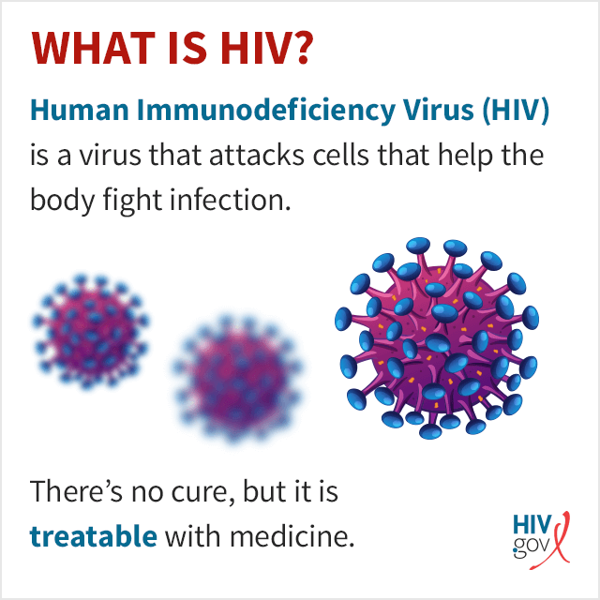
Notes:
HIV is a virus that progressively depletes a specific class of T cells in the blood. They make up a big part of the immune system, so immunity to diseases is lost over time.

Slide 11
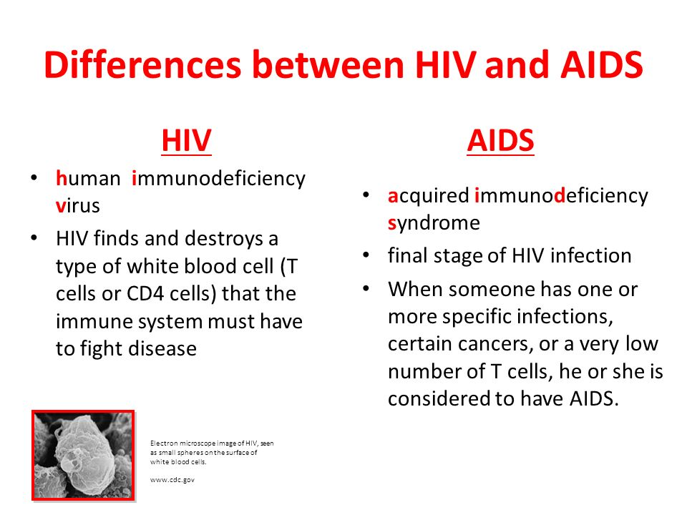
Notes:
HIV eventually progresses to AIDS, which is a clinical diagnosis of very little immune protection due to HIV infection. This process can be stopped completely with treatment, but there is no cure for HIV infection.

Slide 12
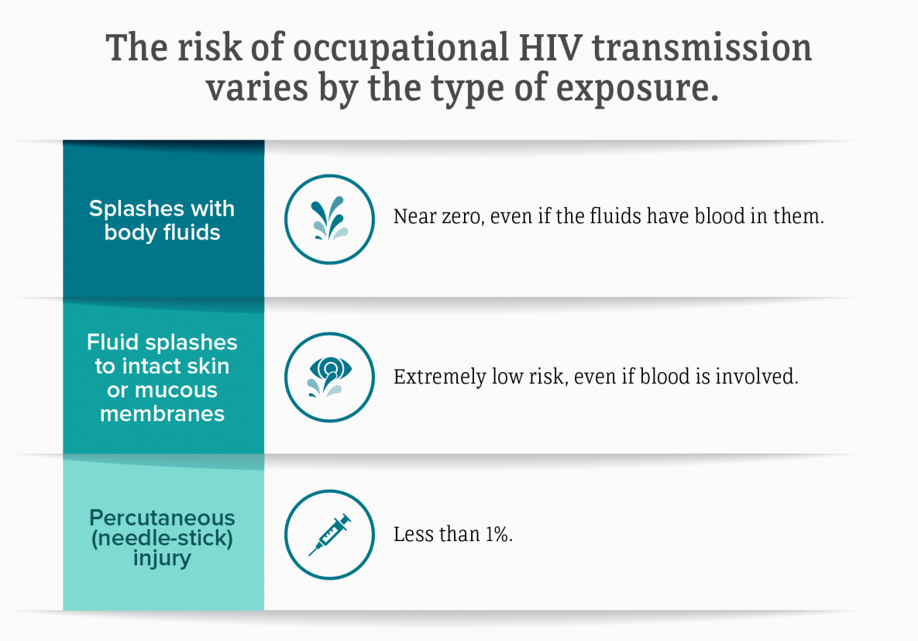
Notes:
Occupational HIV infection is very rare. A splash or needlestick should be avoided but is unlikely to result in infection.

Slide 13
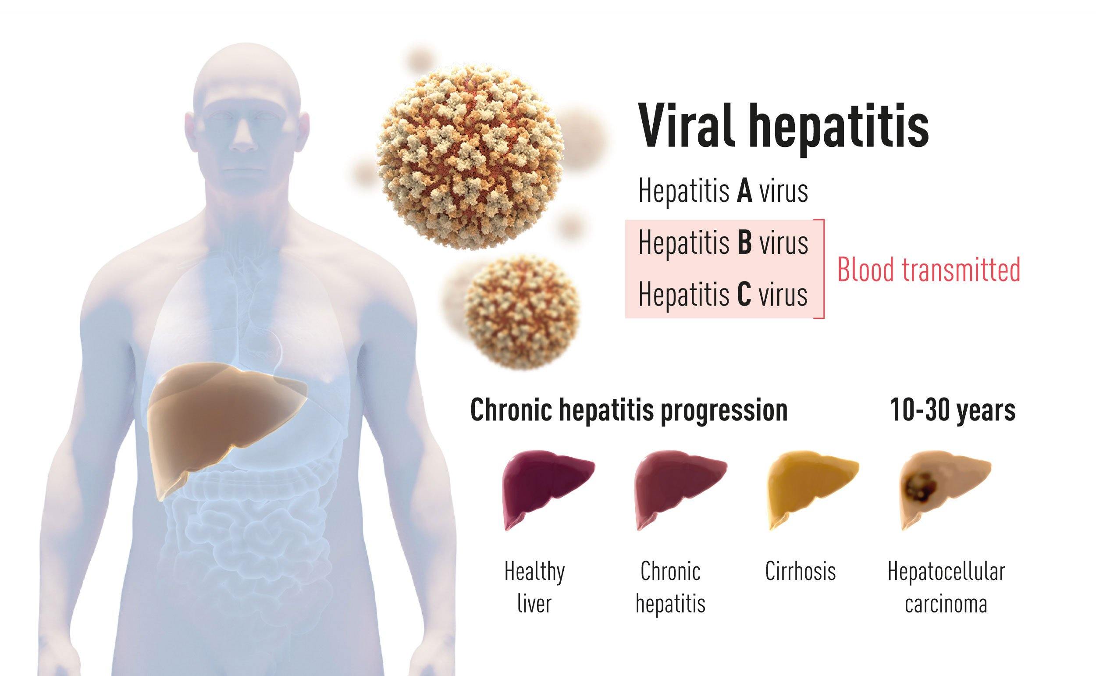
Notes:
Extremely common viruses, there are several of these viruses with similar symptoms. Serious illness generally takes many years to manifest.

Slide 14
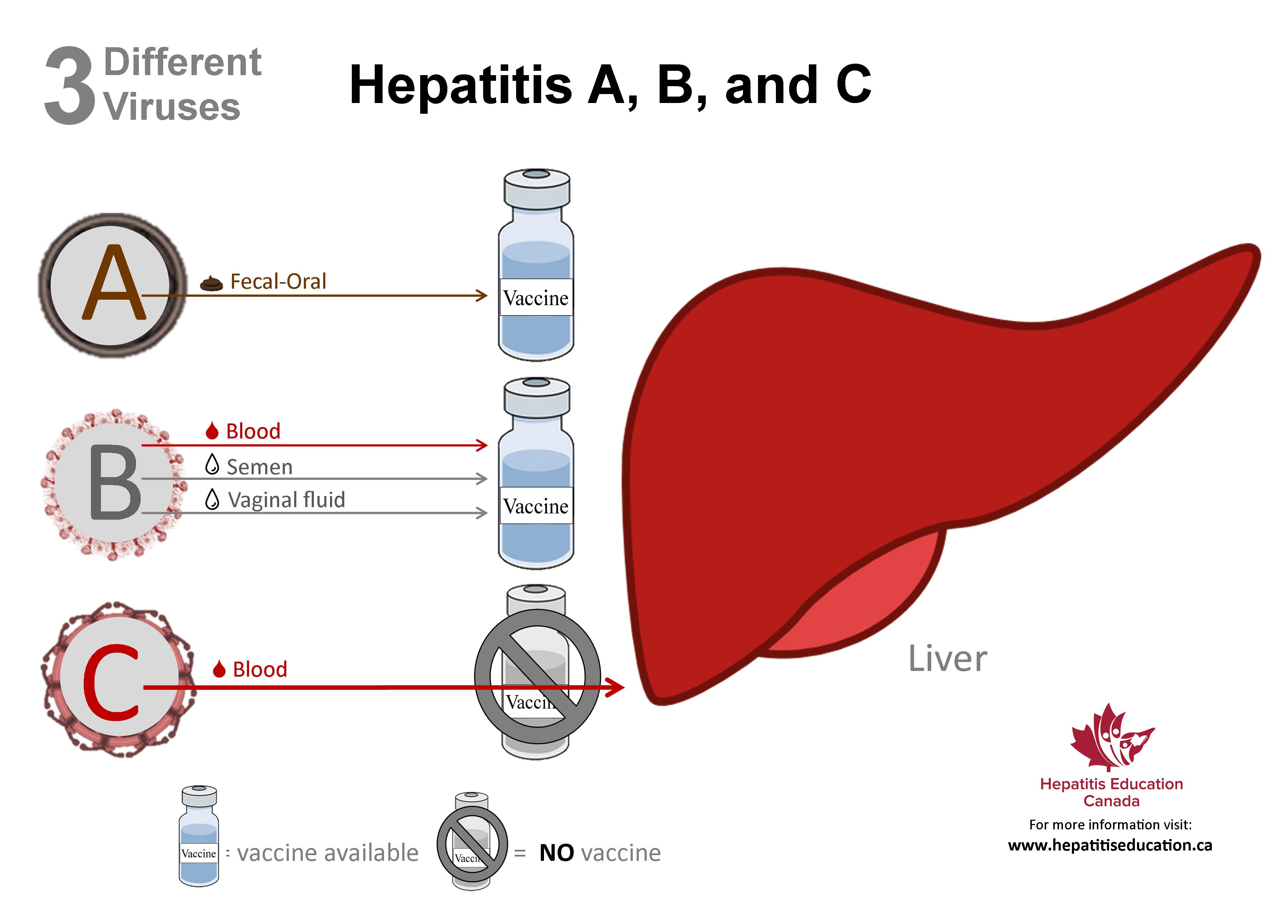
Notes:
Hepatitus B and C are BBP’s. A very good vaccine is available for Hepatitus B.

Slide 15
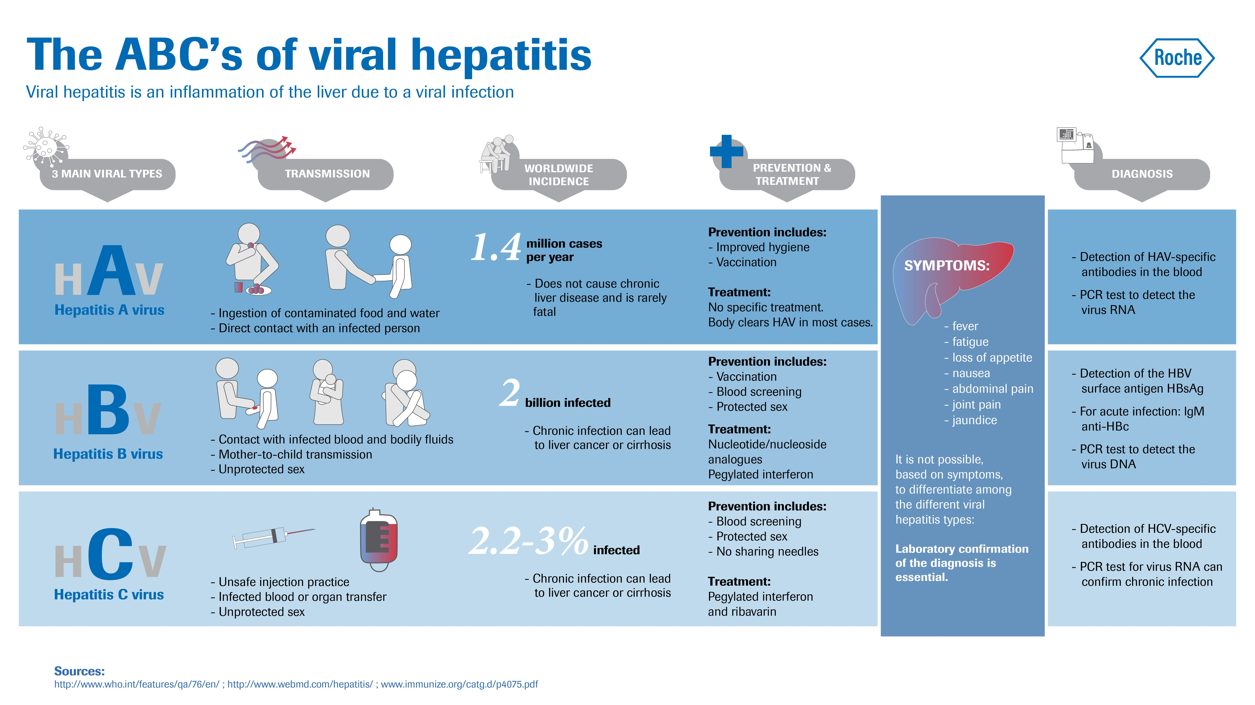
Notes:
Hepatitis is the most common cause of Liver Transplants in the USA. Very commonly present in patient blood.

Slide 16

B Virus
Carried without disease by some research monkeys (Macaques)
Rare transmission to humans
Blisters, Flu-like symptoms
Very rarely fatal
Notes:
B Virus is only a concern when working with Rhesus Macaques, a species of non-human primate (monkey) that is often used in research. These animals are in use at the Tulane National Primate Research Center (TNPRC). Workers there should be familiar with B Virus precautions. This virus is carried by a small number of these animals and has sometimes infected humans.

Slide 17

B Virus
Scratches, Bites, Body Fluids, Surfaces
Wash affected area with soap and water
Treatment Available
Wallet Cards
Notes:
B Virus can survive on surfaces for hours, especially if moist. Additional precautions are needed beyond typical BBP practices. Any surface that has been in contact or nearby these animals must be assumed to be contaminated.

Slide 18

OSHA and BBPs
OSHA- “Occupational Exposure to Bloodborne Pathogens” (29 CFR 1910.1030) http://www.osha.gov/SLTC/bloodbornepathogens/index.html
Notes:
OSHA reference chapter covering BBP’s.

Slide 19

Workplace Hazards and Legal Protections
Employees may work with hazards if they are provided with the means to do so safely.
BBP Exposure Control Plan
Covers any employees with work exposure to BBPs
Notes:
Your workplace will contain hazards. The employer’s responsibility is to provide tools to work safely with those hazards. In the context of BBP’s, this takes the form of a BBP Exposure Control Plan.

Slide 20


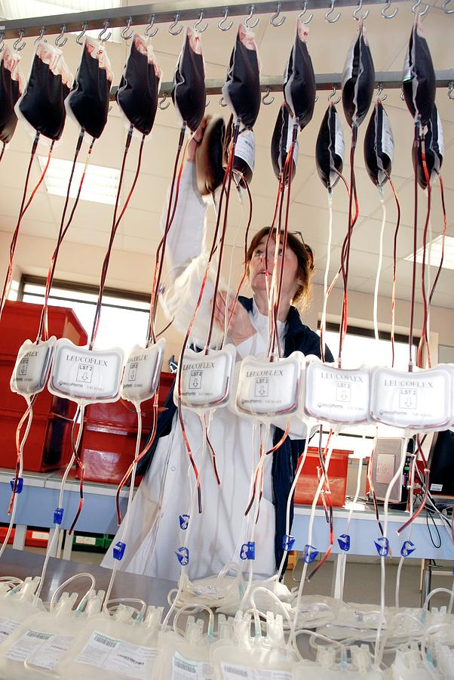
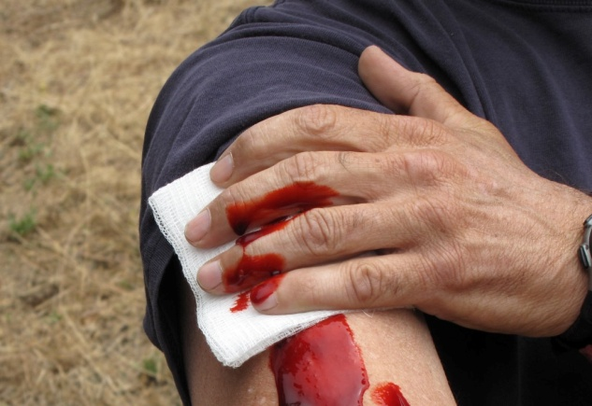
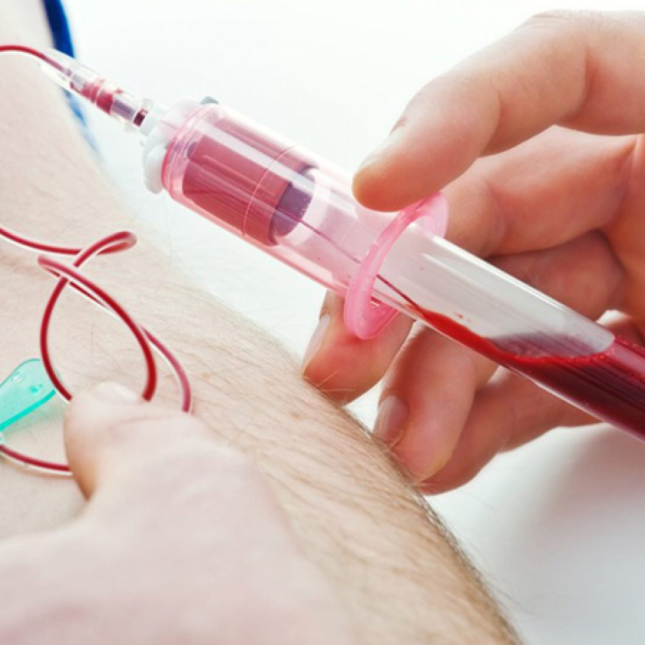
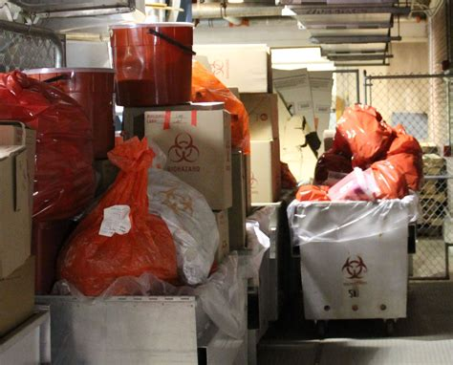
Occupations with BBP Exposure
Notes:
Law enforcement, animal handling, blood draws, blood processing, bio waste or laundry handling. Any jobs where there is potential contact with blood, blood products, or where cuts or scratches with potentially infected persons or animals are likely.

Slide 21

BBP Exposure Control Plan
Engineering and Administrative Controls
Personal Protective Equipment (PPE)
Medical Surveillance
Vaccinations
Training
Notes:
The exposure plan contains all elements of preventing and treating workplace exposures.

Slide 22
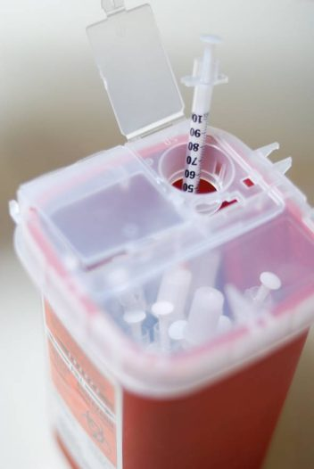
Engineering Controls
Sharps Disposal Containers
Safety-engineered Sharps Devices
Notes:
Sharps Boxes and Devices physically separate users from the hazard of used needles.

Slide 23
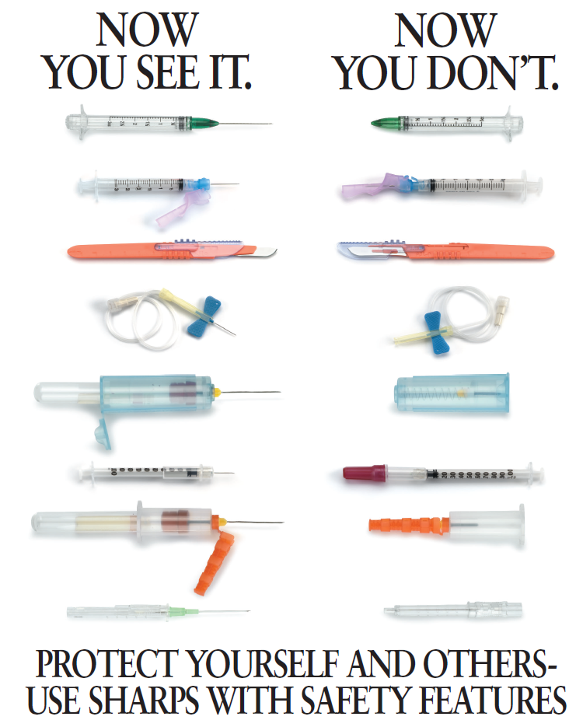
Notes:
Use engineered sharps whenever available. These reduce the chance of a needlestick injury by physically hiding or guarding the sharp point or surface after use.

Slide 24







Administrative Controls or
“Standard Precautions”
Wearing PPE
Washing Hands
Sharps Handling
Labeling/Signage
Waste Disposal
Injury Reporting
Vaccination and Treatment
Notes:
Standard Precaution elements. Following slides will review each of them.

Slide 25
PPE Maintenance
Wear when required
Inspect before donning
Isolate Hazards
Discard/change PPE when contaminated or damaged.
Dirty PPE/Laundry could be infectious
Notes:
Isolate hazards in work areas. Do not wear your PPE into common areas or office areas. Replace damaged or contaminated PPE. Assume used PPE or laundry is infectious. Remember the Rule of Thumb!

Slide 26
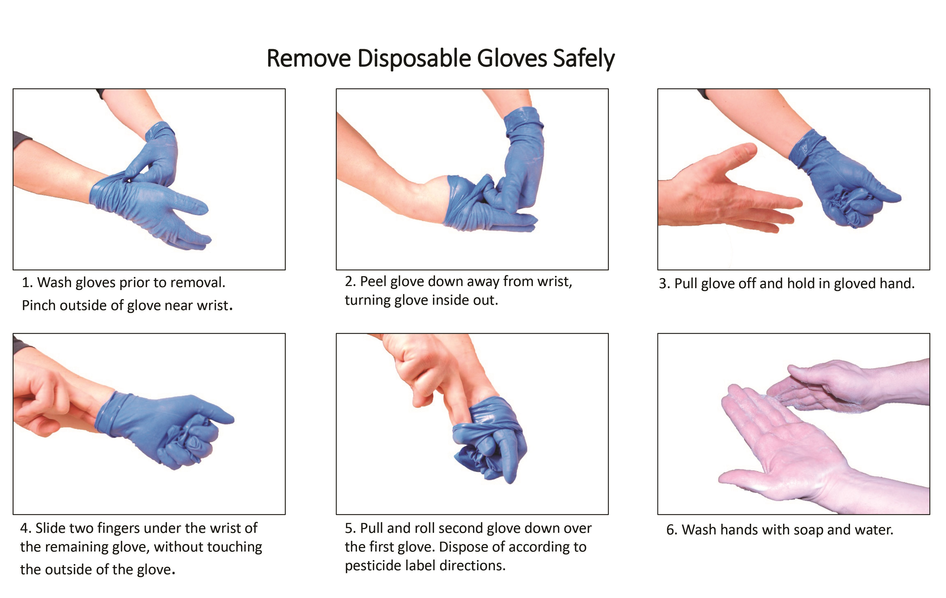
Notes:
Remove PPE without touching the exterior surfaces with your skin. Always wash your hands after removing used PPE.

Slide 27
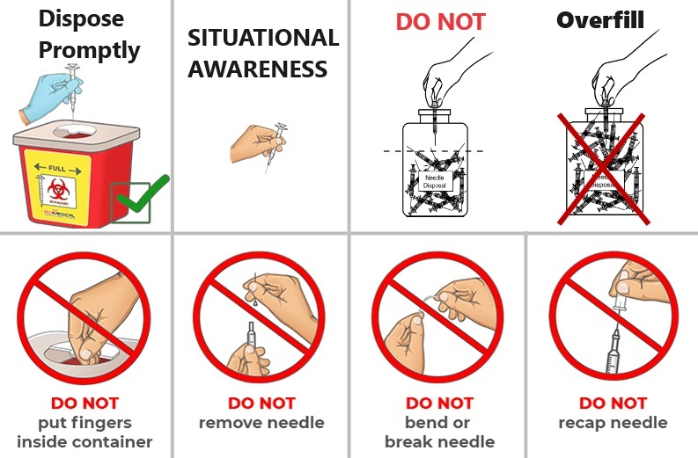
Sharps Safety
Notes:
Correct use of sharps reduces needlestick injuries: Dispose of sharps right away after using. Be aware of where the sharp is in relation to your body, other hand, and any co-workers in the work area. Do not overfill sharps boxes or reach into them. Do not recap or damage needles, just use them and dispose.

Slide 28
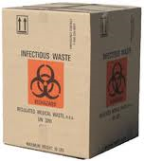
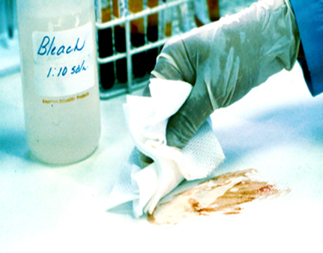

Waste and Signage
Infectious Wastes go in Biohazard Waste Boxes
Clean up spills right away
Post Signage
Notes:
Biohazard signage is needed by entrances to BBP work areas and on any containers that will hold contaminated items (biowaste boxes, sharps boxes, etc).

Slide 29
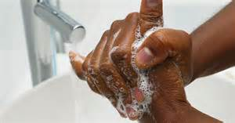
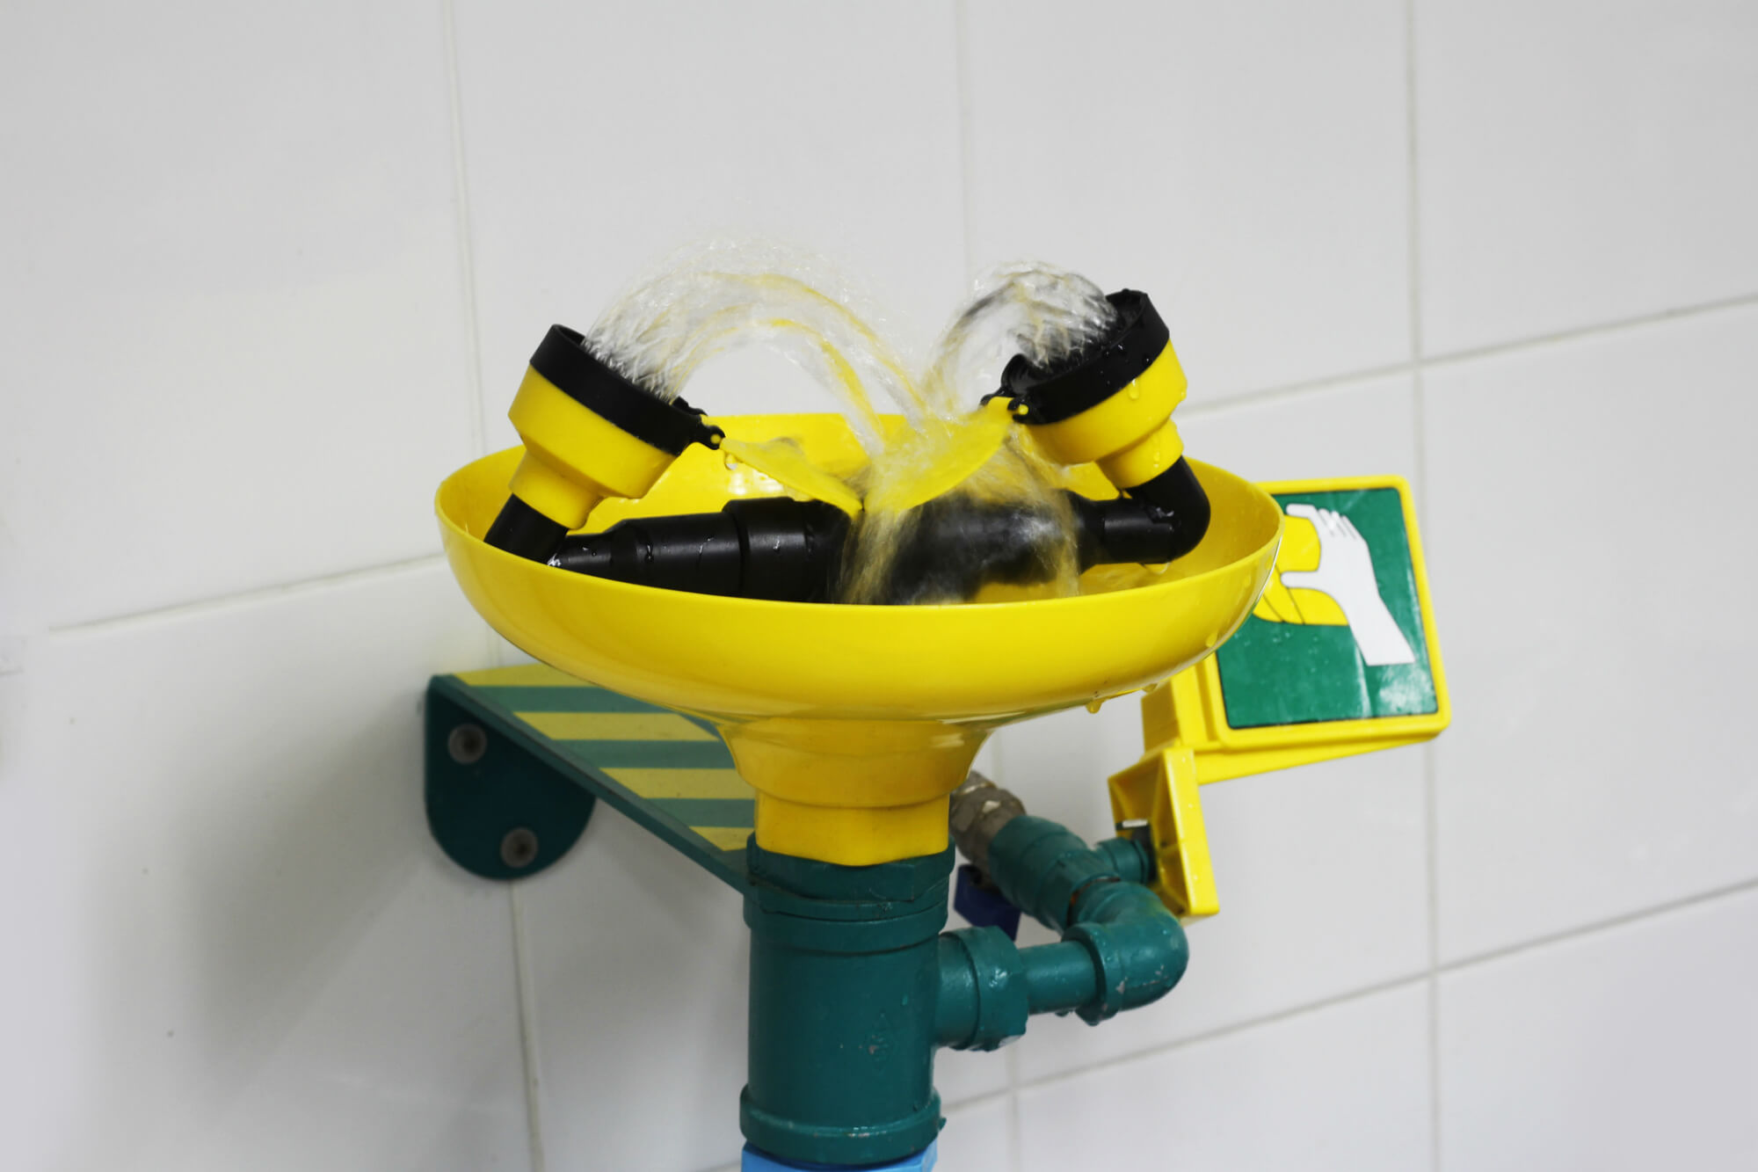
Injury Treatment/Reporting
Wash needlesticks and cuts with soap and water
Flush splashes to nose, mouth, or skin with water
Irrigate eyes with Eyewash
Tell Supervisor
Seek medical treatment
Notes:
Treat BBP splashes and needlesticks by washing with soap and water for 15 minutes or rinsing the affected area with water for 15 minutes. Report all injuries!

Slide 30
Injury Reporting
Contact Occupational Health
Report the injury by calling CORVEL or filling out a Student FROI.
OSHA Reporting
Needlestick/BBP Exposure Reporting
Notes:
Staff and Faculty should call the Corvel hotline: 855-433-9938. Students should complete a “Student FROI Form”. OSHA requires additional reporting requirements for needlesticks and BBP exposures. You may be asked for additional information about the needlestick (type of needle used, etc).

Slide 31
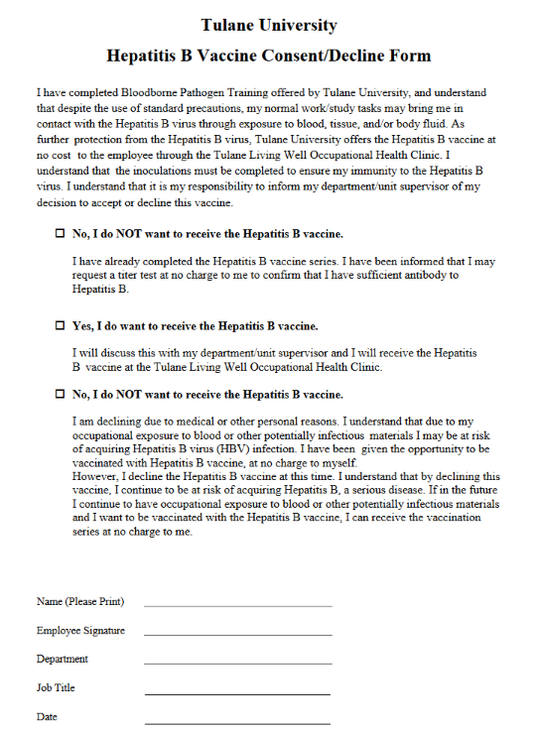
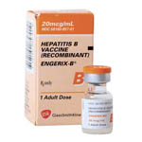
Hep B Vaccine
Highly Effective
Free
Notes:
All employees working with BBP’s must complete this form. You are not required to vaccinate, but Tulane must inform employees that this Vaccine is available to them at no cost.

Slide 32
AGENDA
Blood Borne Pathogens
Formaldehyde
Respirators
Notes:
The agenda. Formaldehyde safety training is required annually if working with formaldehyde.

Slide 33

What is Formaldehyde?
Colorless liquid with an unpleasant odor
Useful for preserving tissues
Often sold as “Formalin” a 10-37% solution
Notes:
Formaldehyde is a very common, useful chemical. If might be in the form of “Formalin”, which is also formaldehyde and requires the same precautions.

Slide 34
What is Formaldehyde?
Toxic and flammable
Produces hazardous vapor
Primary Exposure Route is RESPIRATORY
Notes:
Carries some hazards, the main risk is inhalation of the toxic vapors.

Slide 35
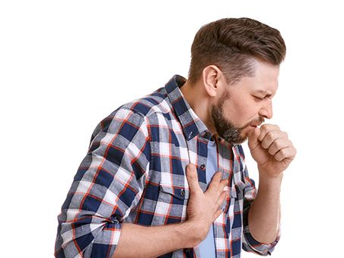
Symptoms of Exposure
Short Term Effects
Irritation –Mouth, Nose, Throat, Lungs.
Lung damage
Notes:
Formaldehyde vapors are very irritating to tissues/lungs. Some users become less bothered by the odor over time (lost sense of smell), others become very sensitive to it.

Slide 36
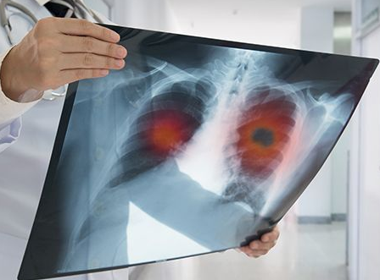
Symptoms of Exposure
Long Term Effects
Irritation
Difficulty Breathing
Sensitizer
Carcinogen
Notes:
Can eventually cause lung cancer and impaired breathing.

Slide 37
OSHA and Formaldehyde
OSHA- “Occupational Safety and Health Standards: Formaldehyde” (29 CFR 1910.1048)
https://www.osha.gov/laws-regs/regulations/standardnumber/1910/1910.1048
Notes:
OSHA chapter covering Formaldehyde. Anyone working with 0.1% or higher formaldehyde solutions must take training on Formaldehyde safety annually.

Slide 38
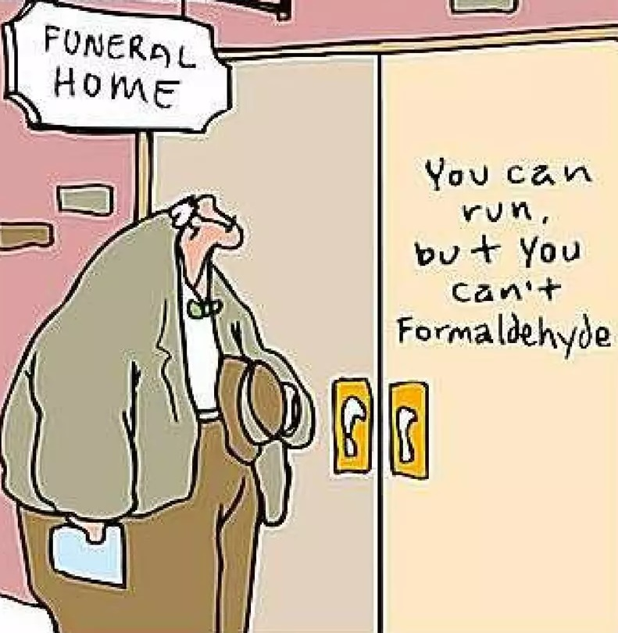
Exposure Assessment
Workers and workplaces with high Formaldehyde use.
On Request.
Estimate of exposure during work week.
Notes:
OEHS can perform exposure assessments of your workplace. Contact us at OEHS@tulane.edu. Exposure Assessments will attempt to estimate how much formaldehyde exposure occurs in a typical work week and if additional Hazard Controls are needed.

Slide 39
Workplace Exposure Limits
Short-Term Exposure Limit
Permissible Exposure Limit
Action Level
15 min Exposure >2 ppm
0.75 ppm average in 8hrs
If exposure is >0.5ppm in 8hrs, further measures required + Medical Surveillance
Notes:
OSHA limits for exposure, both acute and chronic. If we find the limit is exceeded, actions must be taken to lower exposure (introduce more Hazard Controls).

Slide 40

Medical Evaluation
Required if:
Exposure above Action Level
Symptoms of Exposure
Exposed due to a Spill
Notes:
A medical evaluation is a visit with a healthcare professional to determine if the worker’s health has been affected by a formaldehyde exposure. Can be done at a Tulane Occupational Health Clinic.

Slide 41
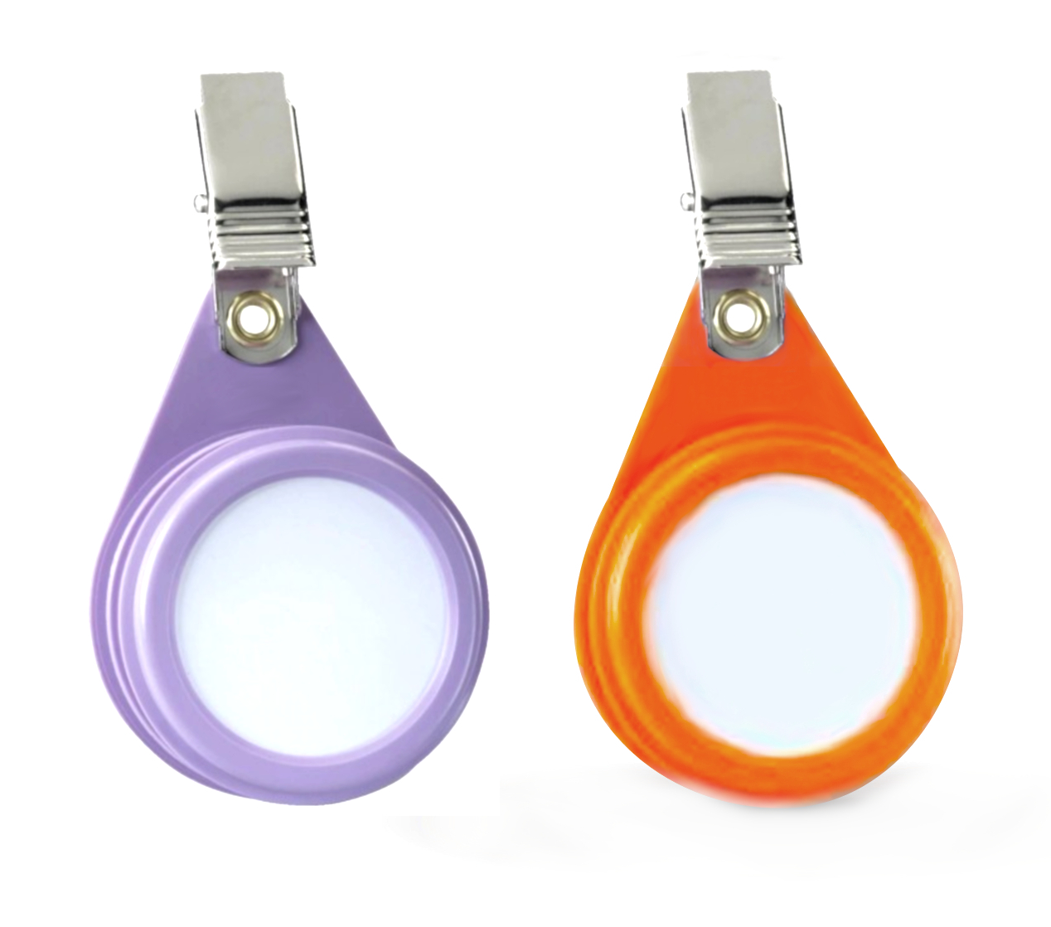
Exposure Monitoring
Formaldehyde Badge
Absorbs vapors throughout work day
Notes:
Formaldehyde badges absorb vapors and are assayed to determine how much formaldehyde the worker is being exposed to. Worn by workers with exposures close to the Action Level to monitor exposure amounts over time.

Slide 42
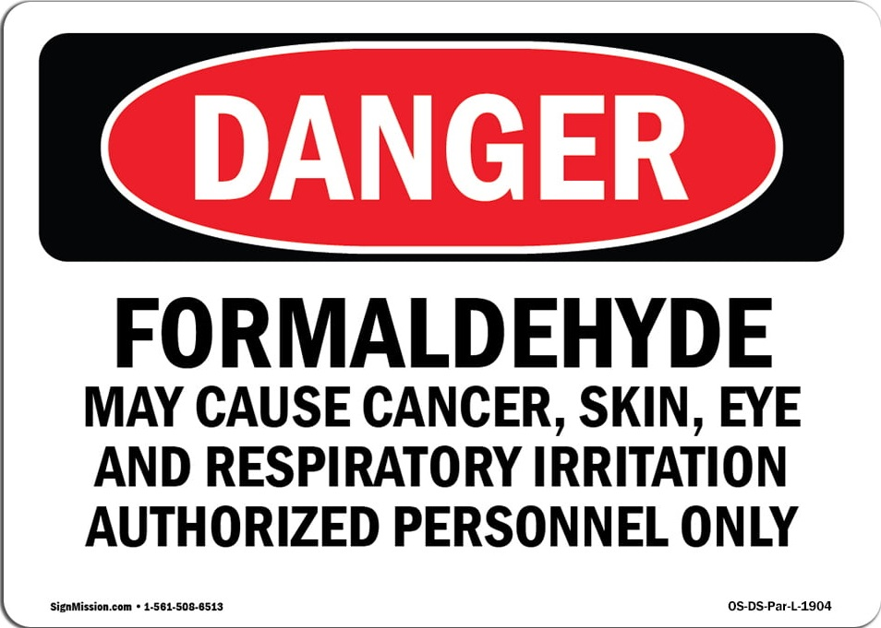
How to Limit Exposure
Administrative Controls:
Training (>0.1%)
Best Practices
Injury/Spill Response
Signage
Notes:
Administrative controls should be in place to reduce exposure. Training of everyone working with Formaldehyde will familiarize them with best practices, what to do after an exposure, and proper spill response. Areas where formaldehyde action levels are reached should have signage indicating that Formaldehyde is present.

Slide 43
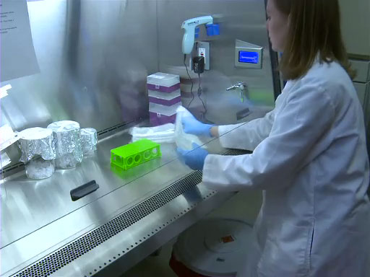
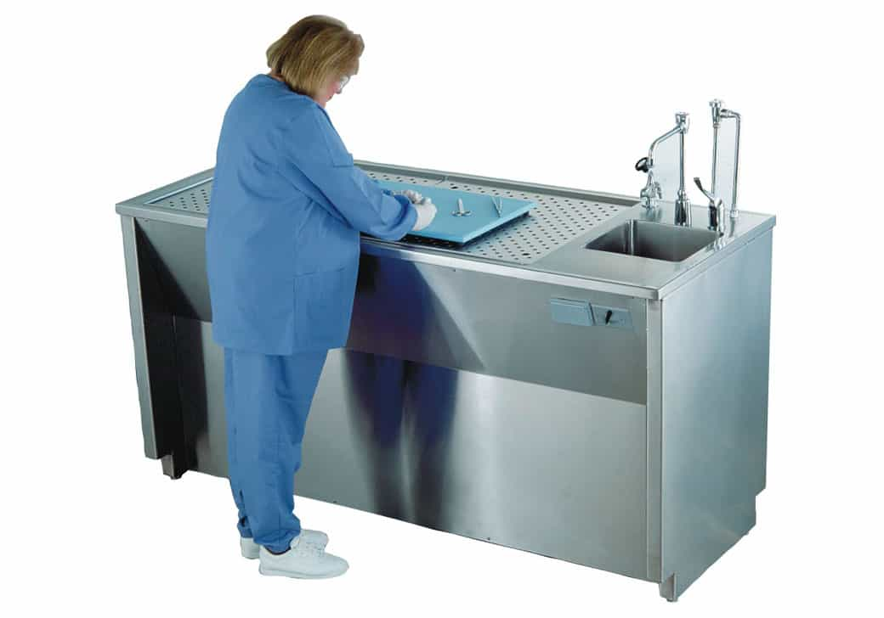
How to Limit Exposure
Engineering Controls:
Fume Hood
Downdraft Table
Snorkel
PPE:
Gloves
Lab Coat/Apron/Boots
Goggles/Face Shield
Respirator
Notes:
Engineering controls physically separate workers from formaldehyde vapors (ventilation equipment such as fume hoods). PPE should be worn to reduce skin contact. Respirators are not be the best hazard control for formaldehyde but may be required if other controls are not available.

Slide 44
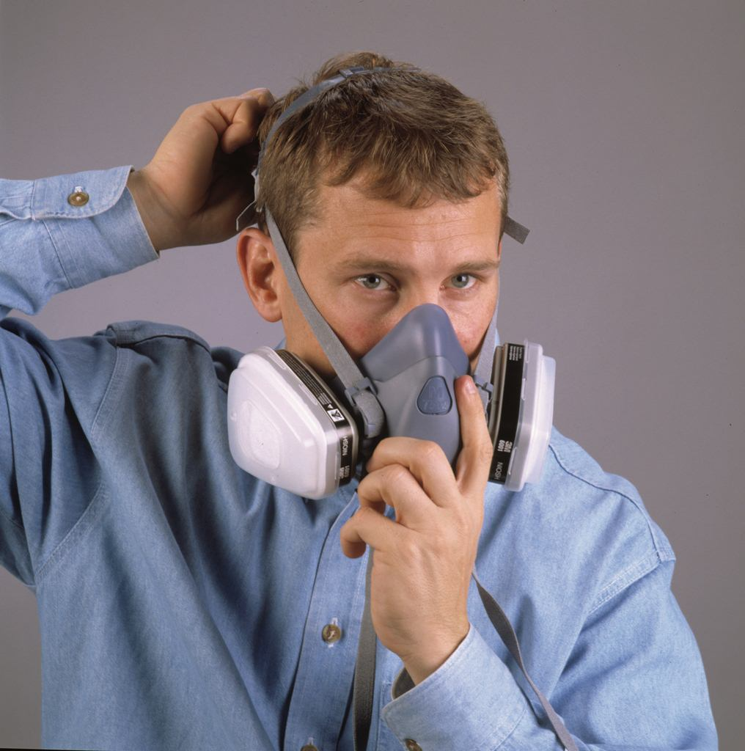
Respirators
Required if:
Exposure cannot be reduced below limits.
Controls are not available.
Notes:
If exposure cannot be reduced below action levels with other controls, respirators can be used. Cartridges specific to Formaldehyde vapors should be used.

Slide 45
AGENDA
Blood Borne Pathogens
Formaldehyde
Respirators
Notes:
The agenda. Use of respirators requires annual training and fit testing.

Slide 46
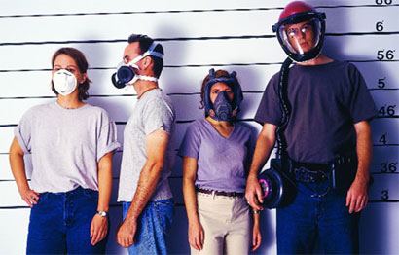
Wear the Right Respirator
N-95 Half-Face or PAPR
Full-Face Cartridge
Notes:
N-95s are a filter mask (no protection from vapors), but still require a fit test. Cartridges filter out vapors based on the type of cartridge used. PAPR has a fan that pushes air through a filter to the face. PAPR does not require fit testing. Not pictured are SCUBA respirators. These use a supply of compressed air similar to a scuba diving tank.

Slide 47
Wear the Right Respirator
N-95
Cartridge
PAPR
SCUBA
Particulates
Depends on the Cartridge (Vapors, Particles)
Depends on the Filter (Vapors, Particles)
Low Oxygen or Very Toxic Condtions
Notes:
N-95s are a filter mask (no protection from vapors), but still require a fit test. Cartridges filter out vapors based on the type of cartridge used. PAPR has a fan that pushes air through a filter to the face. PAPR does not require fit testing. Not pictured are SCUBA respirators. These use a supply of compressed air similar to a scuba diving tank and protect from low oxygen or toxic gas environments.

Slide 48
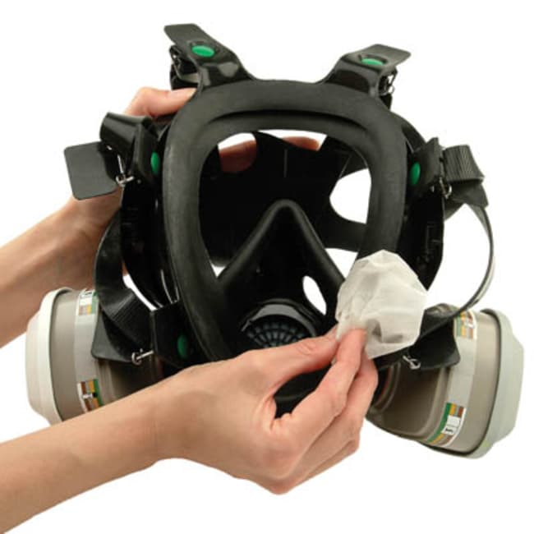
Maintenance
Clean after Use
Replace as needed
Seal Check
Cartridges
Notes:
Always keep PPE clean and inspect for defects. Perform a “Seal Check” prior to using the respirator by covering intakes and breathing in or out. You should feel pressure in the mask.
Cartridges should be selected for the exposure type and changed out as needed.

Slide 49
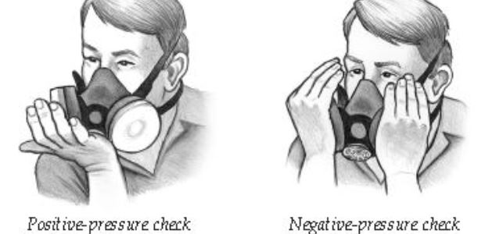
Seal Check
Perform a “Seal Check” prior to using the respirator.
Notes:
Perform a “Seal Check” prior to using the respirator by covering intakes and breathing in and out. You should feel positive and negative pressure in the mask if there is a tight seal.

Slide 50
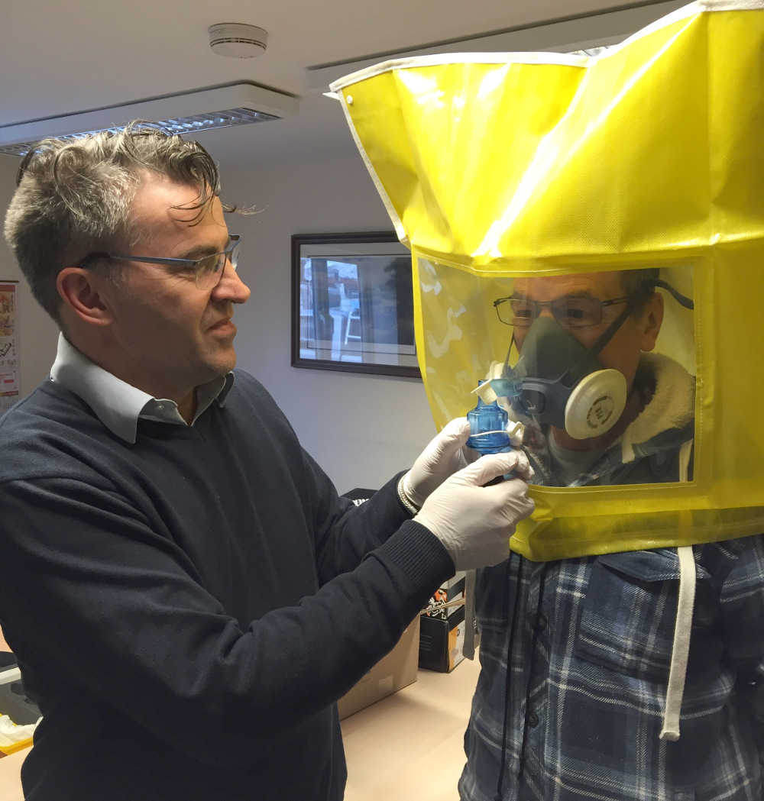
Fit Tests
Required Annually
Occupational Health
No Beards!
Notes:
An annual test of the respirator’s function. Needed because faces and respirators can change shape over time. This test ensures the respirator is still working for that user. Occupational health can perform them. Ensures that the seal on your mask is tight. Heavy facial hair must be removed to get a good seal.

Slide 51
Medical Questionnaire
Checklist of Health Problems
Reviewed by Physician
Notes:
A confidential questionnaire must be completed annually before the fit test. It screens for common health problems that would interfere with wearing a respirator. These are reviewed by a physician who authorizes use of the respirator.

Slide 52
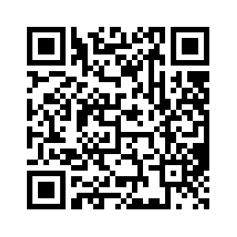
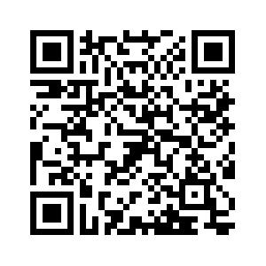
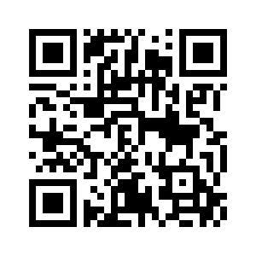
OEHS Safety Training Bio Labs Unit – Quiz
Staff/Faculty – search on TULearn
https://tulane.bridgeapp.com/learner/courses/1457aa1e/enroll
Students – CANVAS
https://tulane.instructure.com/courses/2281002/quizzes/4204124 Access Code: scishield
Training Portal Signup:
https://tulane.instructure.com/enroll/JL4C6A
Notes:
Follow the appropriate link to the quiz. It is 25 questions and takes less than 10 minutes to finish. Students who are blocked from it on Canvas will need to be added to the 2024 Compliance Training first. Get their emails and add them, then unlock the quiz for them via “Moderate This Quiz” button on the right side of the quiz page.

Slide 53

Any Questions??

